Slide 1
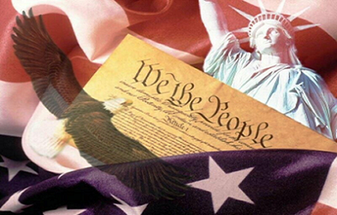
Civic Literacy for K-5
New Jersey Center for Civic Education
Rutgers, the State University, Piscataway, NJ
https://civiced.rutgers.edu

Slide 2

Shared Folder for Today’s Workshop
https://drive.google.com/drive/u/1/folders/169TlE698cA7tIB2k7QYTdQgxPDkYAIHy

Slide 3
Why teach civics?
"An educated citizenry is a vital requisite for our survival as a free people…if we think them not enlightened enough to exercise their control with a wholesome discretion, the remedy is…to inform their discretion by education”
Thomas Jefferson, 1820
Public schools were instituted to create citizens
Significant research indicates that ELL skills can be taught by engaging students in relevant social studies issues

Slide 4
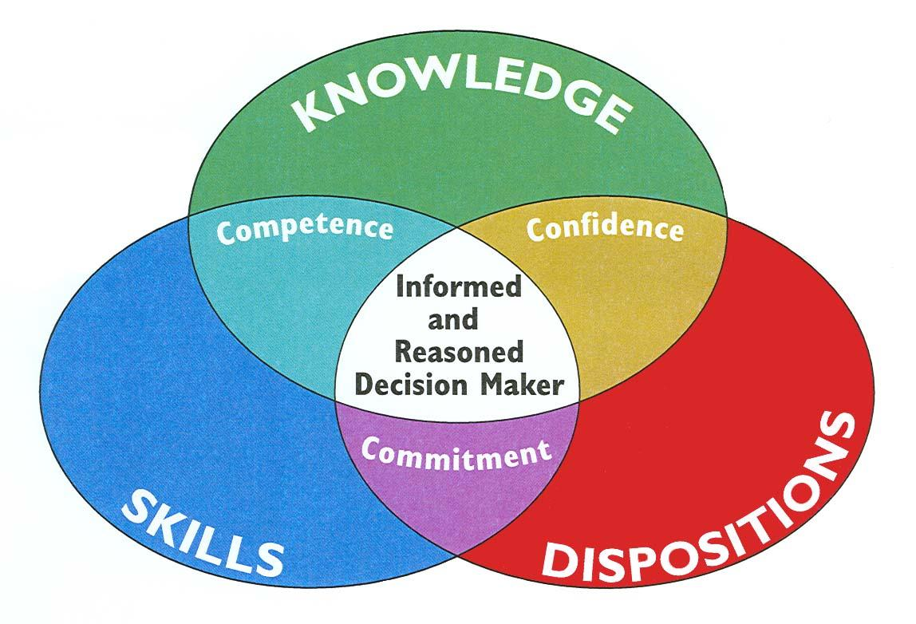
How Can We Develop Informed, Engaged Citizens for a Democratic Society?
Notes:
How can we develop informed, engaged citizens for a democratic society? Well it’s more than knowledge:
Knowledge—of history, government and political philosophy - is important. But we also need to develop
Skills - for citizenship. Critical thinking, Active listening, Analysis, and public speaking. And
The dispositions or willingness to use their knowledge and skills
When, those three things come together students will develop the Competence, Confidence, and Commitment to DO civics - to engage with others and to participate in their community.

Slide 5
New Jersey Student Learning Standards for Social Studies
  Mission: “Social studies education provides learners with the knowledge, skills, attitudes and perspectives needed to become active, informed citizens and contributing members of local, state, national, and global communities.”
  Vision: ”An education in social studies fosters a population that is civic-minded, globally aware and socially responsible.”
  The 2020 Social Studies standards greatly increased the focus on civics in elementary grades, especially active student engagement, using technology and investigating issues by grade 5.

Slide 6
Practices for NJ Social Studies Learning Standards
Developing Questions and Planning Inquiry
Gathering and Evaluating Sources
Seeking Diverse Perspectives
Developing Claims and Using Evidence
Presenting Arguments and Explanations
Engaging in Civil Discourse and Critiquing
Conclusions
Taking Informed Action
Social Studies - NJ Student learning Standards
Notes:
This is the list of practices in the NJ Social Studies Learning Standards.
They may sound sophisticated, but young children can and should learn how to ask questions, gather and evaluate sources including diverse perspectives.
They should learn to develop claims (opinions) supported by evidence and be able to explain the positions they have taken.
We need to teach our children starting at a young age how to engage in civil discourse and the skills for taking informed action.

Slide 7
Dispositions and Skills Developed
Social and Emotional Learning
Civic Dispositions and Skills
English Language Arts
Active Listening
Self-awareness
Self-regulation
Social awareness
Relationship building
Civil discourse
Close reading
Concerns for rights of others
Corroboration
Critical thinking
Incorporating evidence
Individual responsibility
Open-mindedness
Patience
Persistence
Problem-solving
Respect
Critical Thinking
Public Speaking
Reading
Writing
Notes:
Here is another way of showing the adjacent benefits of teaching Civic Dispositions and skills. You can see the list of Civic disposition and skills listed . By involving your students in learning these,
they will be engaged in Social and Emotional skills, such as active listening and self and social awareness and possibly relationship building.
Students will be using and developing language arts skills like reading, writing, critical thinking and public speaking.
We’ll look at this again after we provide some background and do some activities that you might use in your classroom.

Slide 8
Core Civics Concepts
How do citizens, civic ideals, and government institutions interact to balance the needs of individuals and the common good?
Community
Common Good
Rules and Laws
Authority/Government
Responsibility
Rights/Fairness
Decision-making
The Role of the Citizen
American Values
Notes:
We’ve aggregated the many performance expectations within the Social Studies standards into nine core civics concepts:
Community
Common Good
Rules and Laws
Authority/Government
Responsibility
Fairness
Decision-making
The role of the citizen
Conclude with American Values
These 9 core civics concepts will guide over the next few hours as we share resources, activities and lessons you can share with your students. We’ll email the whole ppt to you need to take extensive notes!

Slide 9
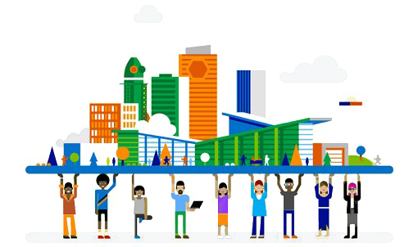
What is a community?
A group of people living in the same place or having common interests or goals

Slide 10
What community do you belong to?
Many!
  Family
  Friends
  Neighborhood
  School
  Classroom
  Religious organizations
  Town
  State
  Country

Slide 11
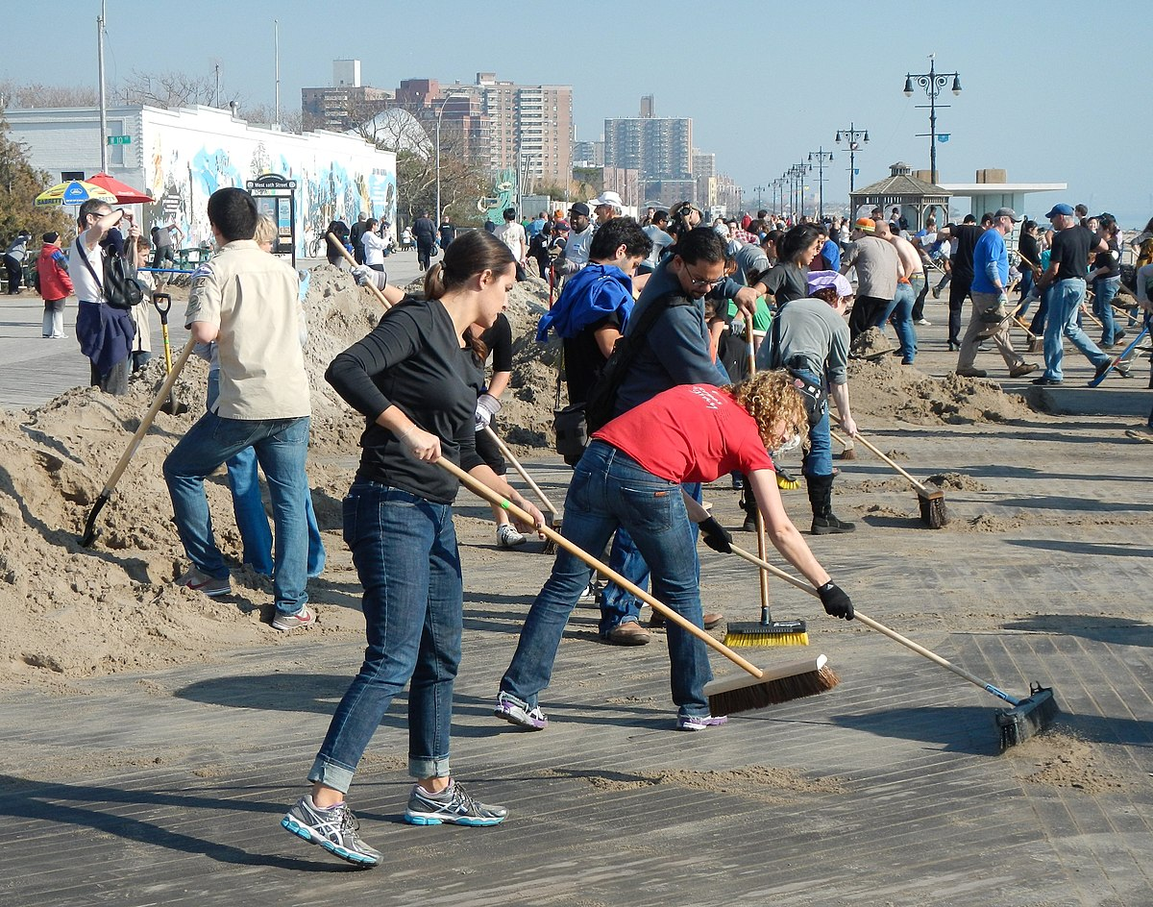
Create a picture wall
Community Helpers
https://www.educatingforamericandemocracy.org/educator-resources/?sword=&grade-level[]=229#popup-ead-post-7004
Notes:
What’s going on in the photo? Who are these community helpers and what are they doing? Cleaning up after a storm.
This is an image of Community Helpers from Educating for American Democracy at: https://www.educatingforamericandemocracy.org/educator-resources/?sword=&grade-level[]=229#popup-ead-post-7004
You could have your students find or draw pictures of people doing things to help their communities and create a picture wall
Educating for American Democracy materials are both free and online. You just need to register and then sign in.
Kid Citizen

Slide 12
What is the common good?
Definition What is best for the group as a whole, or something that benefits everyone? | Characteristics
Examples | Non-examples
Draw or find
an illustration
Frayer Model
Notes:
So, how do you get your students to understand what the common good is?
You could use the Frayer Model for each civic concept, such as the common good. You can have students complete this on paper or on their iPads. You can provide definitions but also encourage students to rewrite in their own words.
You could have them draw or find images that illustrate the common good. Some of them may be similar to the community helpers that we just saw, but the common good might also be served by serving in the military, teaching, serving as a member of a town council or school board, or even peacefully protesting. It might be good for your students to consider this.

Slide 13
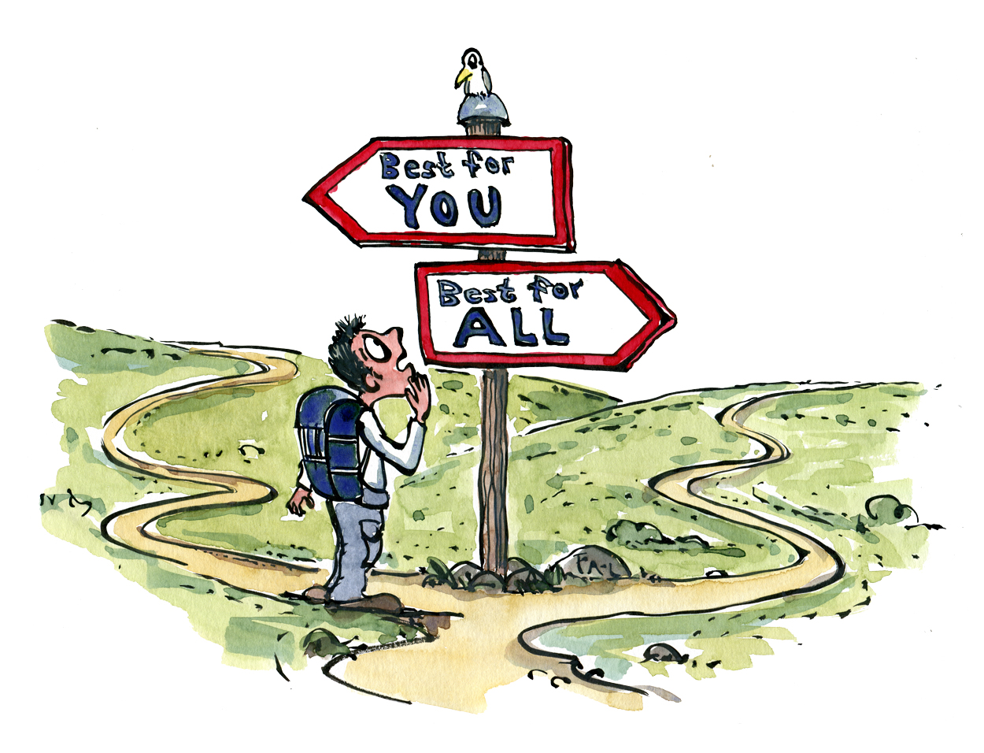
The Common Good

Slide 14
What is the Common Good?
Actions or activities that are shared and beneficial for all or most members of a given community. This operates at both the government and individual levels:
  Actions that governments take that are either shared or for the beneficial of the whole community
  Individuals acting for the benefit or interests of the larger society rather than one’s own selfish interests
The idea of the common good is based on philosophical concepts from the ancient Greek and Roman Republics as well as religious principles.
The common good is attainable only by the community, yet individually shared by its members.

Slide 15
Working Together for the Common Good
Give examples of people who have contributed to the common good.
EAD lesson about leaders who have actively improved society at https://www.educatingforamericandemocracy.org/educator-resources/?sword=&grade-level[]=229#popup-ead-post-6387
Why is it important for members of a community to work together for the common good?
  That’s the only way we can improve our community/our world!
Notes:
9You might ask for examples of people who have contributed to the common good.
Give examples of people who have contributed to the common good and how? Let’s see another EAD lesson about leaders who have actively improved society at https://www.educatingforamericandemocracy.org/educator-resources/?sword=&grade-level[]=229#popup-ead-post-6387. It looks at Elizabeth Cady Stanton and her fight for the women’s right to vote.
Who might you sugges
You might ask WHY is it important to work together for the common good? What would be your answer? Why is it important to work together for the common good,
That’s the only way we can improve our community/our world!

Slide 16
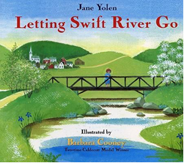
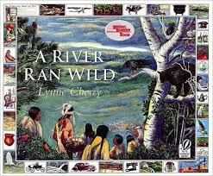
Making Decisions for the Common Good
Letting Swift River Run (Janet Yolen, 1992)--residents of a town make a decision for the common good to let Swift River be dammed and turned into a reservoir to supply drinking water for the larger community.
A River Ran Wild (Lynne Cherry, 1992)--a true story about the pollution and ultimate cleaning of the Nashua River in Massachusetts when citizens took action.
Notes:
Letting Swift River Go by Jane Yolen is a story about a place, about change, and most importantly about community decision making for “the common good”.
Swift River winds through a bucolic valley of homes, farms, stores, and churches
The city of Boston, 60 miles away, needed water and the valley had good, clean, cold water running between the low hills
The members of the community met and agreed to trade water for money (thru the process of eminent domain)
So they moved the graves and the houses, cut down the trees, and built a dam. “The water moved in slowly and silently” for seven years until the towns were all gone. Now Quabbin Reservoir provides water, boating, a place for fish and memories.
The details in the book may not ALL be real, but the Quabbin River was dammed in the 1930s to create a reservoir to provide water to 40 communities in Greater Boston.
A River Ran Wild by Lynne Cherry—is the true story about the pollution and ultimate cleaning of the Nashua River in Massachusetts when citizens took action
You might connect these stories with activities closer to home—like decisions to clean up 22 miles of the lower Hackensack River from Oradell Dam to Newark Bay: first the decision by the government to designate it as a superfund site for dredging contaminants and capping it, but then also ongoing annual trash removal by volunteers (see https://www.hackensackriverkeeper.org/rivercleanupprogram)

Slide 17
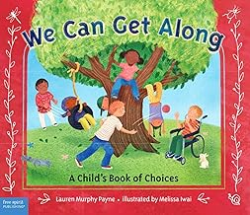

How do we work together for the common good?
Respect each other
Listen to each other
Share with each other
Consider other views
Compromise
Agree on what is best for most people
6.1.2.CivicsPI.5: Describe how communities work to accomplish common tasks, establish responsibilities and fulfill roles of authority

Slide 18

What Is Authority?
The right and the power to make and/or enforce decisions about rules and laws for a community.

Slide 19
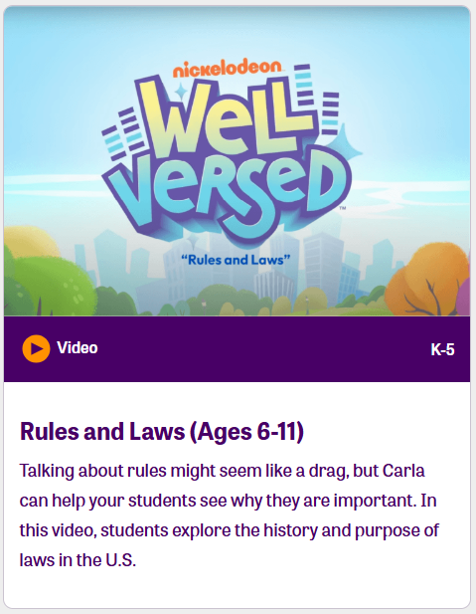

Why do we need rules and authority?
Notes:
9:41-3 ARLENE
iCivics has a series of short videos for elementary grades. Click and go to the Rules and Authority. Show 1 minutes and ask teachers what they think? It’s cute, and iCivics is free and online and has a lot of material. You just need to register.

Slide 20
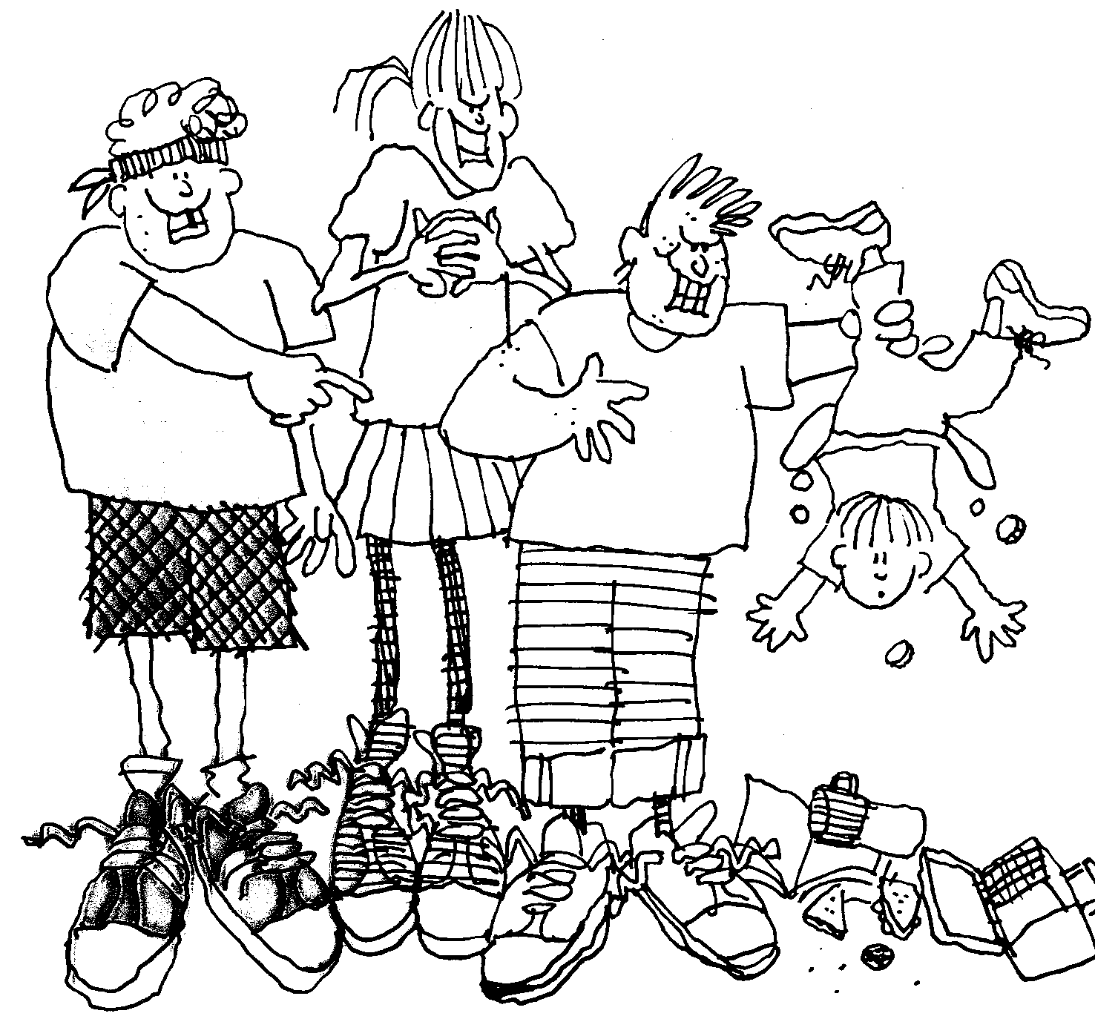
What if we had no laws, no government, no one with authority?
Notes:
You might alternatively, start with an activity that can be done by students in ANY GRADE…
Imagine that you live on an island far away. There are no rules, no laws and no government. There is no one to tell you what to do.
ASK AND WAIT FOR RESPONSES: What might happen if there were no rules, laws or government?
Chaos. The strong would take advantage of the weak.

Slide 21
Why do we need rules and authority?
To protect the weak from the strong
To protect individual rights
To keep us safe
To help us keep order
To settle arguments
To help us share things in a fair way
6.1.2.CivicsPR.2: Cite evidence that explains why rules and laws are necessary at home, in school and communities.
Notes:
Why do we need rules and authority?
To protect the weak from the strong
To protect individual rights
To provide for order and safety
To settle arguments
To ensure that benefits and burdens are fairly shared
This helps students to appreciate WHY we need and have authority in school and at home and also provides a civic context for understanding why we need government and rules for society to function peacefully. And it meets a specific social studies standard!

Slide 22
Proposed class rules:
Only girls can have lunch in school
Any student over 5 feet tall must leave school
Class will not be held when the sun and the stars align
Students will raise their hand to ask a question
Recess will only be held on alternating Thursdays
No dogs are allowed in school
Notes:
Let’s look at some possible class rules. Let me know what you think about each of these possible rules for your class:
Only girls can have lunch in school
Is this a good rule? What’s wrong with it? Unfair. What is the purpose of it?
Any student over 5 feet tall must leave school
Again, what’s wrong? Purpose. Sometimes height is relevant—when a truck or bus goes through a tunnel. On some rides at amusement parks. But no reason for it here.
Class will not be held when the sun and the stars align
What is this even talking about? Maybe it’s trying to say there would be no school when there’s an eclipse, but it is certainly not clear.
Students will raise their hand to ask a question.
Now this is reasonable. Purpose. Clear. Fair.
Recess will only be held on alternating Thursdays.
Need to be enforceable.
No dogs are allowed in school
What if a student needed a seeing eye dog? So, rules need to be flexible.
These are crazy rules. They are purposely ridiculous so that the students can point out the problem. And they’re fun. You may want to develop your own rules—silly or serious ones!

Slide 23
What makes a good law or rule?
A good law or rule should:
  Have a legitimate purpose
  Be fair
  Be clear
  Be flexible
  Be enforceable
  Be consistent with constitutionally guaranteed individual rights
6.1.2.CivicsPR.1: Determine what makes a good rule or law
Notes:
And the crazy rules might help your students to understand what we need to make a good rule or law. ASK: So, what makes a good law or rule?
A good rule or law should:
Have a legitimate purpose
Be fair
Be clear
Be flexible
Be enforceable
Be consistent with constitutionally guaranteed individual rights
Some teachers have been starting the school year by doing a what makes a good rule activity and then involving their students in developing class rule or a Class Constitution. Have any of you been doing this?.
And many of these teachers reported that their students were more likely to follow the rules when they were part of establishing them. This is actually what democracy is about—we the people rather than the king or queen or dictator make the rules either directly or through our authorized representatives. You would be modeling this in your classroom.

Slide 24

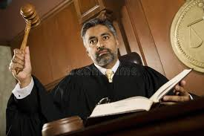
What is the difference between power and authority?
    Power is the ability to control or direct someone or something.
    Authority is power combined with the right to use the power.

Slide 25
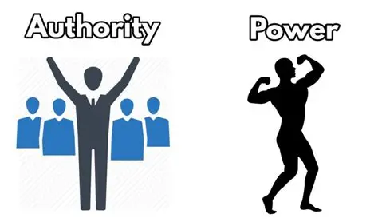
Is it power or authority?
A thief robs you at gunpoint
A parent tells her children to brush their teeth
A teacher assigns homework to his students
Jimmy forces Susie to leave the playground
The legislature bans smoking in restaurants
Notes:
Here are some examples. Tell me if it involves power or authority: If…
a thief robs you a gun point, is that power or authority? (Clearly power only. The thief has no right to point a gun or try to rob you)
a parent tells her children to brush their teeth?(Certainly, a parent has the right to ask his or her children to act in a way that is safe and healthy)
a teacher assigns homework to his students? (Authority)
Jimmy forces Susie to leave the playground? (Power)
The legislature bans smoking is restaurants? (Authority)
Would these examples help your students understand why some people have the authority to tell them what to do but others don’t? Again, you may want to come up with your own examples.

Slide 26
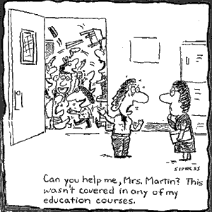
Where does the right to exercise authority come from?
Consent
Custom
Rules and laws
A job or position
Morality
Notes:
Teachers, police officers, parents, governors, presidents and even lifeguards have authority to tell people what to do. Where does this RIGHT come from?
Consent—we vote
Custom—kings, parents (or an usher telling people to stand in line)
Rules and Laws—teacher, school principal, police (some overlap with custom)
A job or position (again, some overlap with rules and laws—e,g, police have authority based on their position, but the authority of the position comes from the law that gives the position certain authority
Morality—religious leaders
These short lessons about AUTHORITY are from Foundations of Democracy by the Center for Civic Education (Show the books). I think these materials are quite good, esp. for elementary grades. But they currently being updated and are not currently available. But you will have this ppt. to use until the updated books are available.

Slide 27
How does a bully make others do what he/she wants?
    Power (force)
    Fear
    Peer pressure
What can you do to stop a bully?
    Speak up
    Tell someone in authority
    Fight back
    Get others to support you
Notes:
Unfortunately, sometimes people use power but they do not have the right. Our most obvious example is a bully.
How does a Bully make others do what he/she wants? (wait then click and show)
Power (Force)
Fear
Peer pressure (together these equal “intimidation”)
What can you do to stop a bully? (wait then click and show)
Speak up
Tell someone in authority
Fight back
Get others to support you
Understanding the sources and purposes of authority can help your students appreciate that a bully has NO authority!

Slide 28


Children’s Literature
Stand Tall Molly Lou Melon by Patty Lovell
Molly Lou Melon was short, had buck teeth, and a voice like a frog. But her grandmother told her to believe in herself and the world will believe in her too. So, she did. She used her self-confidence to tame a bully.
Bullies Never Win
by Margery Cuyler
Jessica was a worrier. She worried about everything. Brenda was perfect but she picked on Jessica called her “toothpick” and excluded her. Anita befriended Jessica and told her to stand up to bully Brenda. Finally, Jessica stood up and said in a loud voice, “Toothpicks may be thin, but bullies never win!” Brenda had no response.
Notes:
And there is some great children’s literature that may help. Sometimes a story is better than a direct lesson or can reinforce it. There are a number of great books to help reinforce the point that bullies have no authority other than intimidation.
Stand Tall Molly Lou Melon is an absolutely adorable book! Has anybody used it? Molly Lou Melon is short, has buck teeth, and a voice like a frog. But her grandmother told her to believe in herself and the world will believe in her too. She starts at a new school where Ronald Durkin calls her “SHRIMPO” in gym class but she gets a touchdown. He calls her “BUCKY TOOTH BEAVER” but she laughs it off with a stunt. He says she sounds like a duck “HONK HONK” so she says “Quack”. She uses her self-confidence to tame the bully. (The story is also available as a video)
Ok, maybe this is not reality but it has a real point: Bullies work on intimidation so don’t be intimidated.
Another book, Bullies Never Win, makes the same point with a different kind of bully– girl who tries to ostracize worry-wort Jessica until she finally stands up to her.
Questions about authority or the lack thereof?

Slide 29

Abuse of Authority!
Notes:
Sometimes there is a problem even when people DO have authority. Way back in 1958 Dr. Seuss wrote a short story for children, Yertle the Turtle, that has something to say about authority. Are you familiar with it?
Yertle the Turtle is King of the pond on the Island of Sala-ma-Sond.
He wants to see higher.
So he has several turtles climb on each other’s backs so that he can climb on top.
Mack, the plain little turtle at the bottom, complains of pains in his back and shoulders.
King Yertle tells him to be quiet (“I’m King and you’re only a turtle named Mack”) and adds yet more and more turtles, until…
Mack burps and all the turtles, including King Yertle, fall down.
Yertle is now King of the Mud, and the turtles are FREE “as turtles and, maybe, all creatures should be.”

Slide 30
What led to the Declaration of Independence?
ABUSE OF AUTHORITY!
The list of 27 complaints against King George III constitute the proof of the right to rebellion because the British are not protecting the rights of the colonists.
“…these United Colonies are, and of Right ought to be Free and Independent States” declares independence.
The Declaration of Independence was designed for multiple audiences: the King, the colonists, and the world.
Its goals were to rally the troops, win foreign allies, and to announce the creation of a new country.
iCivics activity: Hey, King Get off our backs https://www.icivics.org/search-results?keywords=Hey%2C+King%2C+get+off+our+backs&type=All
Notes:
Now we all know we had a revolution to gain independence from Britain but I’m not sure that many people really understand WHY. What does Yertle the Turtle have to do with the Declaration of Independence?
The Founders claimed that Britain was not protecting the natural rights of the colonists, and that the British government was abusing its authority by claiming that it could impose taxes directly. Unlike their local governments which did tax them—taxation by the British government was not based on consent since the colonists were not represented in the British government. In addition to taxation, the colonists were unhappy with Britain’s efforts to:
limit where they could move (The Proclamation Line prohibited the colonists from settling west of the Appalachian Mountains)
And how they could ship their goods (only to Britain)
The Declaration of Independence lists 27 complaints against King George III as proof of the right to rebellion because the British were not protecting the rights of the colonists.
And concludes that “…these United Colonies are, and of Right ought to be Free and Independent States” declares independence.
So, the Declaration of Independence served several purposes: to declare independence, to rally troops and to win foreign allies. Icivics has an activity: Hey, King, get off our Backs. It is for middle school but you might want to consider it for grade 4 or 5. (If time, go to the website…. https://www.icivics.org/search-results?keywords=Hey%2C+King%2C+get+off+our+backs&type=All

Slide 31
How do we prevent abuse of authority?
Clearly lay out the duties and powers of positions of authority and establishing clear limits to what a person in a position of authority can do.
This is exactly what the representatives at the Federal Convention in Philadelphia did in 1787 in writing the U.S. Constitution
Notes:
Let’s go back to the concepts. How do we prevent abuse of authority?
We do this by:
Clearly laying out the duties and powers of a position of authority, and
Establishing clear limits to what a person in a position of authority can do.
The colonists had come together to fight and win a war against the strongest naval nation in the world. Now they needed to get together to set up a way to govern themselves.
So, they met in Philadelphia over the hot summer of 1787 and set up a structure of government that would prevent abuse of authority

Slide 32

How does the Constitution organize our government to prevent abuse of authority?
Three branches of
government - separation
of powers to check and
balance each other
Separation of Powers
Activity:
What’s for Lunch? https://www.icivics.org/search-results?keywords=Three%20branches%20of%20government
Through the process of creating a healthy school lunch, students simulate the roles of each of the three branches of government.
Notes:
How does the Constitution organize our government to prevent abuse of authority:?
By establishing three branches of government each with its own powers or authority that check
iCivics has another 3 ½ minute video about the Three Branches of Government for elementary grades using a basketball game. Show the start of the video.
Or if that seems too simplistic for grade 4 or 5, there is a Separation of powers activity What’s for Lunch? For middle school that you might use. Through the process of creating a healthy school lunch, students simulated the roles of each of the three branches of government.

Slide 33
How does the Constitution organize our government to prevent abuse of authority?
Limited Government: Congress was only given authority over certain activities
Federalism: Authority over some activities was left to the states
Some authority was reserved by the people
We the People: The Citizen and the Constitution, Unit 3 has a series of activities to help students understand how the U.S. Constitution organized our government
Let’s look at how federalism works…
Notes:
In addition to three branches of government—with separation of powers and checks and balances of powers—the Founders also set up a limited government where Congress was only given authority over certain activities
This was a system of Federalism where Authority over some activities was left to the states
Some authority was reserved by the people
We the People: The Citizen and the Constitution, Unit 3 has a series of activities to help students understand how the U.S. Constitution organized our government—SHOW THE BOOK
Let’s look at how federalism works…

Slide 34
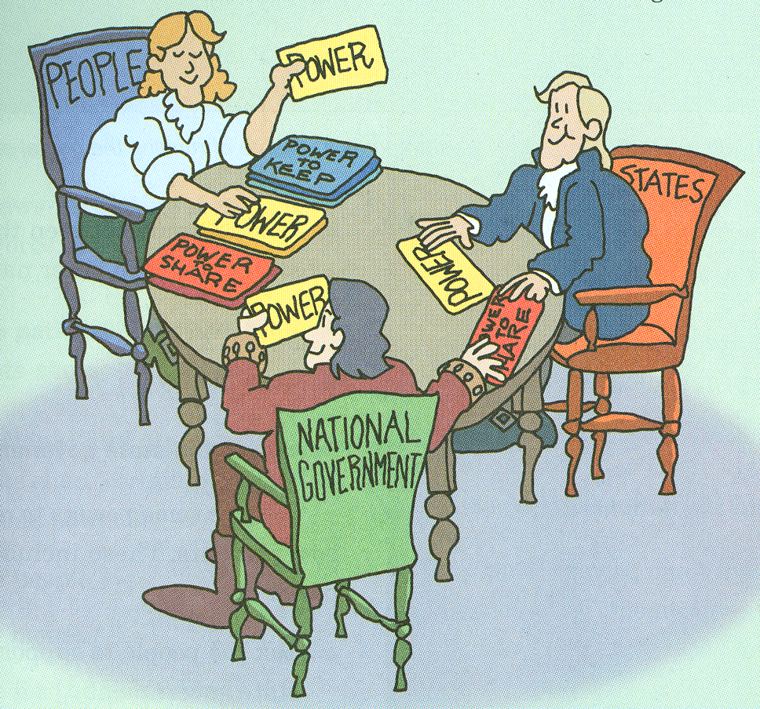
How does Federalism work?
6.1.5.CivicsPI.7: Explain how national and state governments share power in the federal system of government
6.1.5.CivicsPI.6: Describe how the U.S. Constitution defines and limits the power of government
Notes:
This is an image from the upper elementary We the People text showing the People giving the power to the states and national government and the state and national governments sharing some powers..
You might do this activity using cards with powers over topics, such as immigration, foreign affairs, money, etc. from the Constitution, and hand them out to each group of three. Assign a student in each group to be “the people,” “the national government,” and “the state government and let the people hand the cards to the government that has the authority.
We’re just going to do this in pairs. Here is (Hand out 1) the relevant portions of the Constitution and the powers that we want to consider (Handout 2) Indicate “N” for national government, “S” for state government, or “B” for both:
__________To Raise an Army
__________To Conduct Elections
__________To Establish local governments
__________To Collect taxes
__________To Build roads
__________To Coin money
__________To Establish courts
__________To Make and enforce laws
__________To Declare war
__________To Establish post offices
__________To Regulate commerce within the states
__________To Regulate commerce with foreign nations
__________To Take measures for public safety

Slide 35
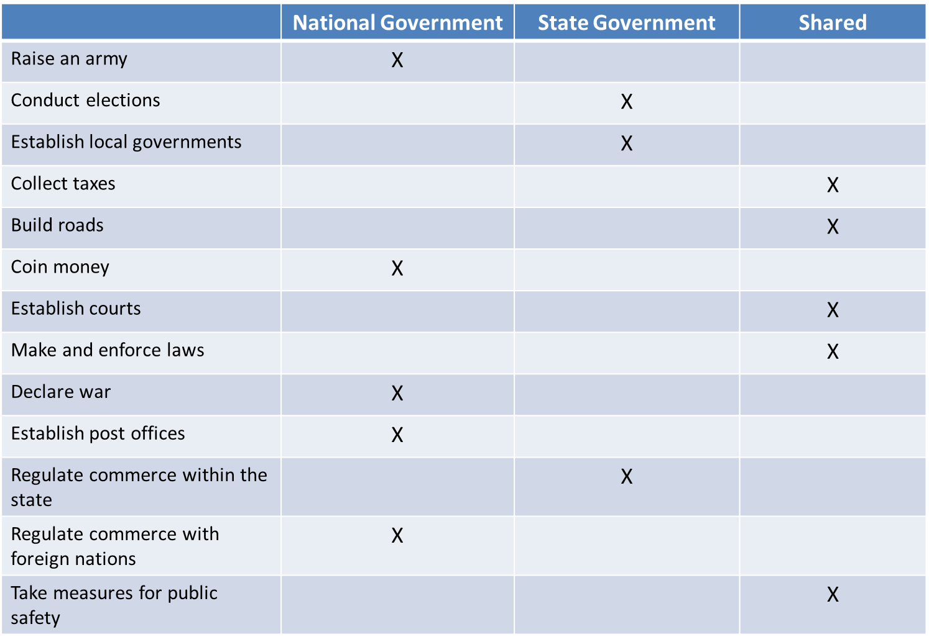
Who has the power?
Notes:
The completed chart should look like this: the national government has exclusive power to raise an army, coin money, declare war, establish post offices and regulate commerce with foreign nations.
State governments have exclusive authority to conduct elections, establish local governments and schools and to regulate commerce with the state (which we didn’t include).
Both levels of government share the ability to collect taxes, build roads, establish courts, make end enforce laws and take measures for public safety.
The people are the source of the power, which they consent to give to the state and national governments for the common good. If you want, you might add: “Determine religious beliefs, express opinions and join others to petition or protest” which are left to the people and not given to any government (which is not true in all countries).

Slide 36
Separation of powers
 | Executive | Legislative | Judicial
National Government | President | Congress: Senate and House of Representatives | U.S. Supreme Court Appellate Courts Federal District Courts
State Government | Governor | State Legislature: Senate and Assembly | NJ State Supreme Court NJ Appellate Courts NJ Superior Courts (by County)
County Government | County Supervisor or Administrator | Board of Commissioners | No separate courts (see above)
Municipal Government | Mayor | Town council | Municipal courts (limited jurisdiction)
School Board | Superintendent | School Board | Administrative Office of the Courts—Commissioner of Education
Notes:
This chart is showing “federalism” going vertically from local to state to national, and “separation of powers” horizontally at all levels:
You want students to understand that the three branches of government function not just at the national level but also at the state and local levels.
Legislatures at all levels make laws—local town councils, state legislatures as well as congress.
Executives carry out and enforce laws, whether it is the President of the United States, the Governor of NJ or the mayor of your town.
The Judiciary settles disagreements about laws—in federal courts, state courts and municipal courts.

Slide 37
New Jersey’s Governor
Who can be Governor of New Jersey?
What is the source of the New Jersey’s governor’s authority?
What authority does New Jersey’s governor have?
What positions does the governor of New Jersey appoint?
Does New Jersey’s governor have a lot or a little authority?
NJ Governor lessons at New Jersey History and Government Lessons
Notes:
In 2014, for the celebration of the 350th founding of New Jersey as a British colony in 1664, the NJ Historic Commission gave the NJ Center for Civic Education a grant to prepare materials about New Jersey’s history and government. So we have lots of free, online resources about NJ history for K-5, including an extensive one with several parts about New Jersey’s governor.
Has anybody seen or used any of these lessons?
Click https://civiced.rutgers.edu/nj-lessons and scroll down to lessons for Grades 3-5 and go to the governor lesson online to show it.

Slide 38
New Jersey State Constitution
Article V, Section I
The executive power shall be vested in a Governor.
The Governor shall be not less than thirty years of age, and shall have been for at least twenty years a citizen of the United States, and a resident of this State seven years next before his election…
No member of Congress or person holding any office or position of profit, under this State or the United States, shall be Governor…
The Governor shall be elected by the legally qualified voters of this States. The person receiving the greatest number of votes shall be the Governor…
The term of office of the Governor shall be four years, beginning at noon of the third Tuesday in January next following his election, and ending at noon of the third Tuesday in January four years thereafter. No person who has been elected Governor for two successive terms, including an unexpired term, shall again be eligible for that office until the third Tuesday in January of the fourth year following the expiration of his second term.
Notes:
Let’s Do the lesson about WHO can be governor.
To decide who can be governor of New Jersey, we would need to look at the NJ State Constitution and see what it says.
This is a Handout from the lesson blown up for us to use today.
So let’s take a look at what it requires for somebody to be governor of NJ and put in everyday language: To be governor someone:
Must be 30 years old and live in the state
Can’t be a member of Congress
Must get the greatest number of votes
Can’t serve more than two terms unless it is four years following the end of the second term
So let’s look at some possible candidates…

Slide 39

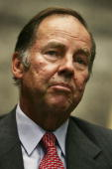
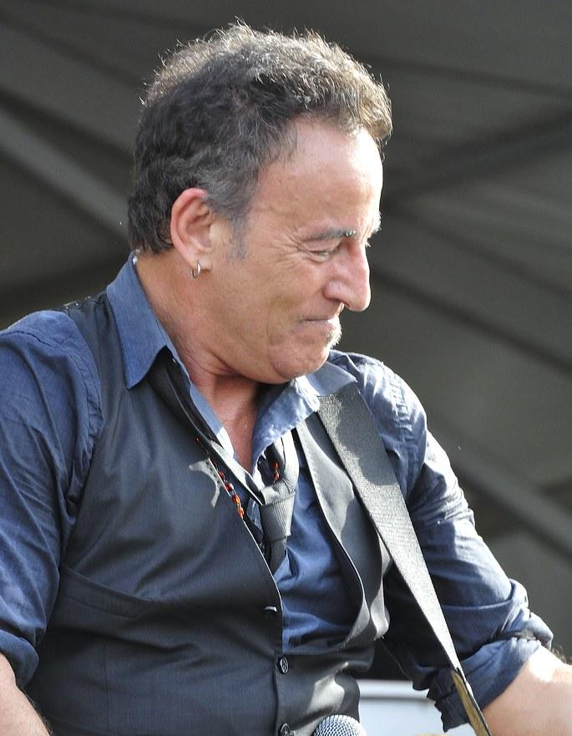
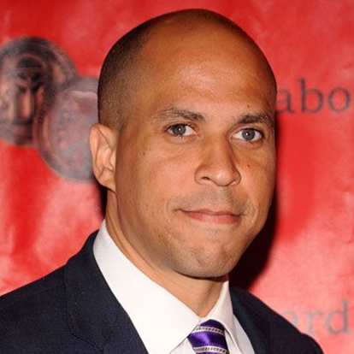
Who can be Governor of New Jersey?
Name: Frankie Jonas
Date and place of birth: Sept. 28, 2000/Ridgewood, New Jersey
Current Residence: Los Angeles, California
Ever held the position of New Jersey Governor? No
Current Occupation: Recording artist, Actor
Name: Thomas H. Kean
Date and place of birth: April 21, 1935/New York City, New York
Current Residence: Bedminster Township, New Jersey (since 1990)
Ever held the position of New Jersey Governor? Yes (1982–1990)
Current Occupation: Lecturer/ Journalist
Name: Bruce Springsteen
Date and place of birth: Sept. 23, 1949/Long Branch, NJ
Current residence: Colts Neck, NJ (one of many)
Ever held position of NJ governor? No
Current occupation: Singer
Name: U.S. Senator Cory Booker
Date and place of birth: April 27, 1969/Washington, D.C.
Current Residence: Newark, New Jersey
Ever held the position of New Jersey Governor? No
Current occupation: U.S. Senator from New Jersey
Notes:
This is another Handout from the lesson blown up, It has some possible candidates (just for fun!)
So who can run for governor of NJ and why or why not?
Frankie Jonas (no, not old enough)
Bruce Springsteen (yes)
Former Gov. Tom Kean Sr. (yes, its been more than 4 yrs since he was governor )
Congressman Cory Booker (no—can’t serve in congress and as governor)
You might discuss who your student might elect and why. Or you can come up with your own candidates.

Slide 40
New Jersey’s Legislature
The legislature is the branch of government that makes new laws and changes old ones. The NJ State Legislature consists of two Houses: a 40-member Senate and an 80-member General Assembly.
The NJ Legislature has the power to enact laws by a majority vote of both houses, subject to a veto by the governor. A vote by 2/3 of each House can override the governor’s veto.
The NJ Legislature makes laws only for the state of New Jersey, while the U.S. Congress creates laws for all fifty states
Go to the district map of the New Jersey legislature at NJ Legislative District Map | NJ Legislature and click on your district number to find out who represents you in Trenton.
Notes:
There’s also a series of activities about New Jersey’s legislative branch, that is our 40-member Senate and an 80-member General Assembly, whose chambers are located in the State House in Trenton.
The New Jersey Legislature has the power to enact laws by a majority vote of both houses, subject to a veto by the governor. A veto may be overridden by the Legislature if there is a two-thirds majority vote in each House to override the governor’s veto.
The New Jersey State Legislature makes laws only for the state of New Jersey, while the U.S. Congress creates laws for all fifty states.
You might at a minimum want to have your students identify their state legislators. You can go to the district map of the New Jersey legislature at https://www.njleg.state.nj.us/districts/njmap210.html and click on your district number to find out who represents you in Trenton. (Go to the map and show it)

Slide 41
New Jersey State House Tours https://www.njstatehousetours.org/
Free Tours of the State House
To schedule a visit, teachers need to reach out to their local Senators and/or Assembly Members.
Contact information is on the New Jersey Legislature website
Resources for Teachers - Teachers | New Jersey Legislative Services, NJ
How a Bill Becomes a Law in NJ: A student’s Guide to the Legislative Process
State House activity book
New Jersey legislators are available to come to schools and offer personal insights into the value of public service and the lawmaking process.
  What does it mean to be a legislator?
  What is a typical day like?
  How did they get involved in public service and why?
  What issues are they most concerned about and what action is being taken?
  What efforts are they most proud of?
  What advice do they give to future legislators?
Notes:
The New Jersey Office of Legislative Services offers tours of the State House as well as classroom resources for teachers. Has anyone brought their class to the Statehouse?
To schedule a visit, teachers need to reach out to their local Senators and/or Assembly Members.
Contact information is on the New Jersey Legislature website (show it)
New Jersey legislators have actively participated in outreach programs, providing personal insights into the value of public service and the lawmaking process during school visits
Resources for Teachers at https://www.njstatehousetours.org/101/Teachers (show it) such as How a Bill Becomes a Law in NJ: A student’s Guide to the Legislative Process (show the print copy)--The organization of NJ’s government, qualifications for legislative service, legislative districts, and citizen involvement also are addressed.
State House activity book-- Elementary school students learn about the State House, state symbols, and lawmaking through puzzles, games, and activities in this printable and fillable PDF activity book.

Slide 42
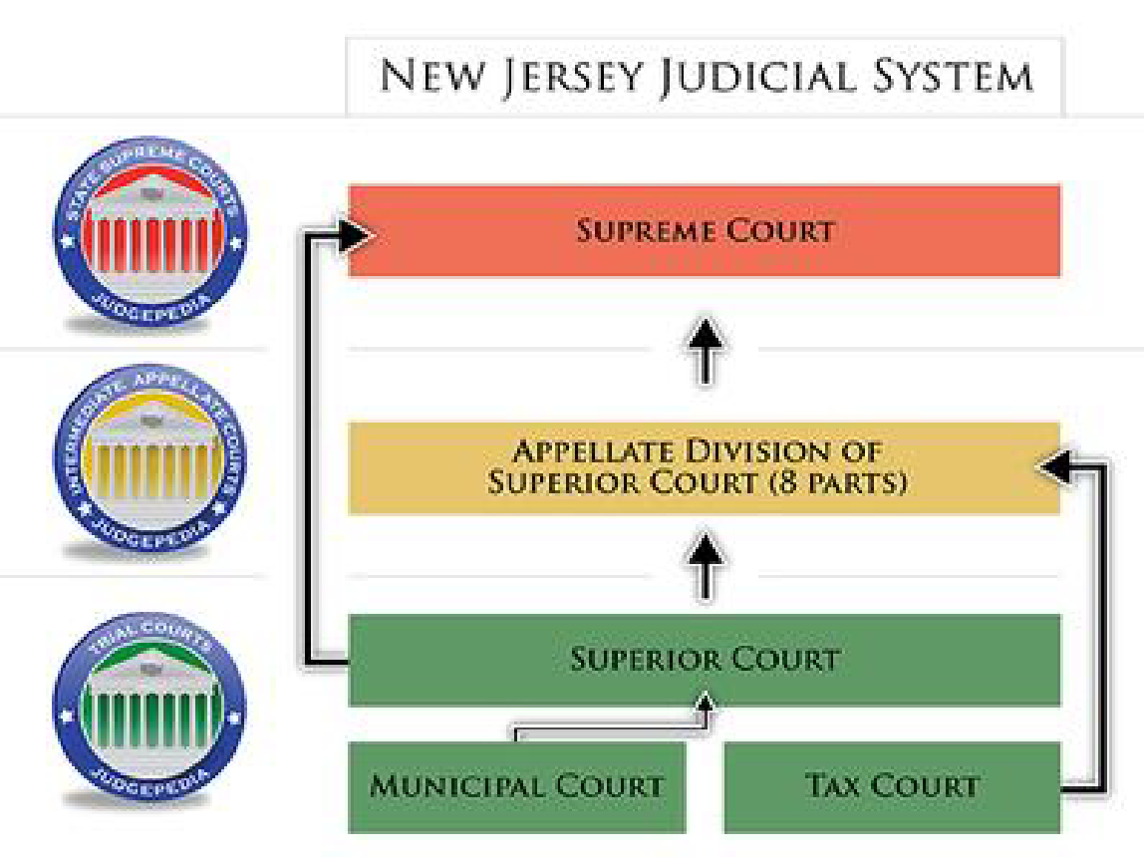
Notes:
This is an overview of the judicial system in New Jersey. There are basically four levels: Municipal courts, Trial Courts, Appellate Courts and the New Jersey State Supreme Court.
Municipalities each appoint their own judges to a municipal courts, which basically deal with traffic and motor vehicle violations, ordinance violations (noise, etc.), disorderly persons and petty offenses
The bulk of court decision-making is done by the Superior Courts—15 of them for 21 counties. They have many divisions: criminal, civil, equity, family, probate. Criminal appeals from municipal cases go to the Superior Court in that county.
There are also specialized courts: a Tax Court for property and state tax issues and a Surrogate Court for probating wills and guardianship of minors.
All cases, including those from Administrative Agencies such as the Dept. of Education, are then appealed to the Appellate Division of Superior Court, which has 33 judges sitting statewide.
Final appeals (assuming no U.S. Constitutional or other federal issue) go to the state Supreme Court, with 7 members.

Slide 43
New Jersey’s Judiciary
New Jersey Supreme Court:
  Resources available for schools at: Student Resources | NJ Courts
  History of the NJ Supreme Court at: Supreme Court Virtual Museum | NJ Courts
  Expanding One Judge, One School program to bring a judge to your classroom
NJ Center for Civic Education has a lesson about New Jersey’s Judiciary at New Jersey History and Government Lessons
  Background on what a law is, what judges and jurors do
  Background and activity on due process/ procedural justice
  Summary of the different types of courts in New Jersey and their functions
  Includes a link to a mock trial for elementary classes and to the NJ Stat Bar Foundation’s Mock Trial program
Notes:
Unlike many other states, the members of New Jersey’s Judiciary are NOT elected. With the exception of municipal judges, NJ’s governor appoints ALL of the judges statewide, with the advice and consent of the NJ Senate.
The NJ Supreme Court has resources available for classes online at https://www.njcourts.gov/public/student-resources (SHOW IT) and about the history of the NJ Supreme Court at https://www.njcourts.gov/public/museum-- may be more appropriate for secondary classes
It is also expanding its One judge, One School program to bring a judge to your classroom. So far only in South jersey. Let me know if this might interest you.
NJ Center for Civic Education has a lesson about New Jersey’s Judiciary at Offers background on what a law is, what judges and jurors do.
Offers background and activity on due process/ procedural justice
Provides a summary of the different types of courts in New Jersey and their functions.
Includes a link to a mock trial for elementary classes and to the NJ State Bar Foundation’s Mock Trial program
.

Slide 44
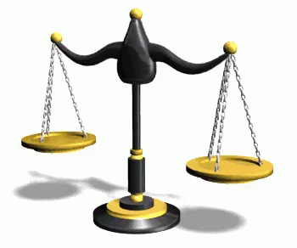
An Independent Judiciary
Is critical to a democracy
Because it is often the final decision-maker
Notes:
We have NOT spent a great deal of time on the roles of the three branches of government because that is in every civics textbook and in the iCivics games. But I thought that it was important to make this one point about the importance of an independent judiciary.
We have a national and a state constitution setting limits on what the executives and legislatures can do, but both constitutions are written in broad terms. It is the courts that interpret these documents. As we have seen dramatically recently, the courts can interpret the constitution in very different ways.
So, the ability of the courts to make independent decisions is very important because the courts (esp. the U.S. Supreme Court) are the final decision-makers.

Slide 45
County government in New Jersey
From 1674 to 1702, the Province of New Jersey was divided into East Jersey and West Jersey, each with its own governor. Counties were created as administrative district courts within each province.
The State of New Jersey entered the union as the 3rd state on December 18, 1787 with a total of 13 counties.
New Jersey would add 8 more counties between 1824 to 1857 bringing the total to 21 counties, where it has remained to this day.
New Jersey counties are run by an elected board of commissioners.
The county board of commissioners serves as both the legislative and executive body (for counties with supervisors or administrators, that person serves as the executive).
Notes:
County government in New Jersey has a long history: From 1674 to 1702, the Province of New Jersey was divided into East Jersey and West Jersey, each with its own governor. Counties were created as administrative district courts within each province.
The State of New Jersey entered the union as the 3rd state on December 18, 1787 with a total of 13 counties.
New Jersey would add 8 more counties between 1824 to 1857 bringing the total to 21 counties, where it has remained to this day.
New Jersey counties are run by an elected board of commissioners (formerly known as freeholders from colonial times).
The county board of commissioners serves as both the legislative and executive body (for counties with supervisors or administrators, that person serves as the executive).

Slide 46
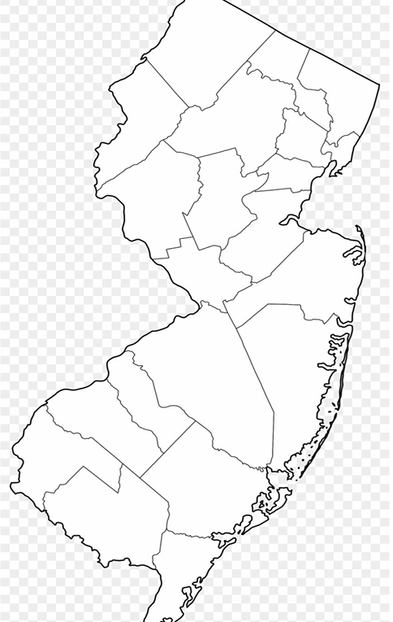
County Government Activity:
Hand out a map of New Jersey with the county lines but no names
Hand out a list with the names of each county
Have your students paste or otherwise match the names of the counties to their locations on the map.
Share a completed state map with counties.
Notes:
Again we have a lesson on our website at Click https://civiced.rutgers.edu/nj-lessons
With an activity for your kids: Can you identify NJ’s counties?
Hand out a map of New Jersey with the county lines but no names
Here’s the map.
Hand out a list with the names of each county if you want to make it easier
Have your students paste or otherwise match or write in the names of the counties in their appropriate locations on the map.

Slide 47
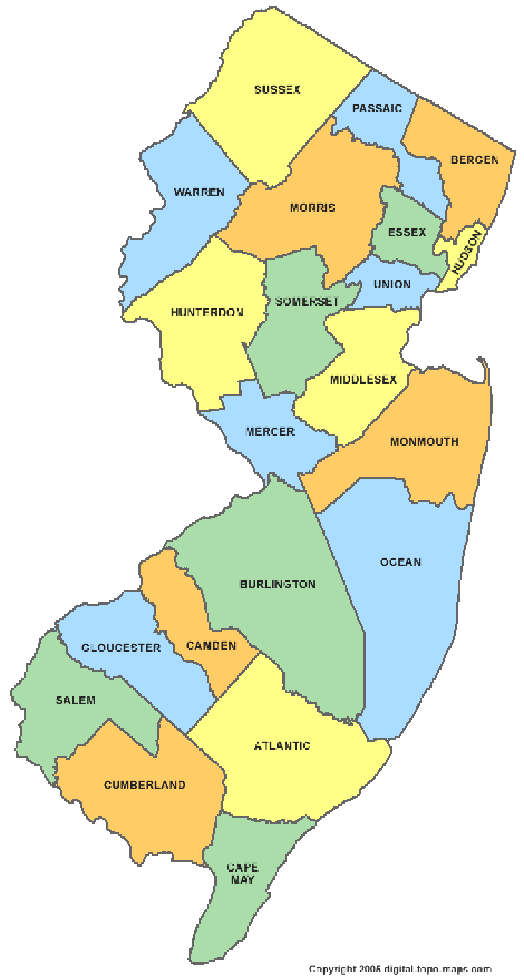
New Jersey’s Counties:
Sussex
Passaic
Bergen
Hudson
Essex
Morris
Warren
Hunterdon
Somerset
Union
Middlesex
Mercer
Monmouth
Ocean
Burlington
Camden
Gloucester
Salem
Cumberland
Cape May
Sing the NJ County Song: https://www.youtube.com/watch?v=HTZGsKpr-FQ
Notes:
Share a completed state map with counties.

Slide 48


Slide 49
Local Government in New Jersey
New Jersey has 564 municipalities
Traditional forms of local government developed over centuries including:
  Borough (mayor and council elected at large)
  City (strong mayor)
  Township (mayor (weak) selected by the committee
each year)
  Town (mayor elected at large, council by wards)
  Village (weak mayor, strong council—village form of
local government was ended by legislation in 1989—now township but can still say “Village of…”)
Why learn about local government?
Bring your class to visit the local government offices or ask a member of local government to visit your class
Notes:
How about NJ’s really local government—the municipalities? New Jersey has 564 municipalities—a lot for a small state. There had been over 600—the state has been encouraging regionalizing towns and school districts.
Traditional forms of local government developed over centuries include:
Borough (mayor and council elected at large)
City (strong mayor)
Township (mayor (weak) selected by the committee each year)
Town (mayor elected at large, council by wards)
Village (weak mayor, strong council--village form of local government was ended by legislation in 1989—now township but can still say “Village of…”)
Do you know what form of government your town has? Have your student find out!
Most importantly: WHY LEARN ABOUT LOCAL GOVERNMENT? Because it probably has the most influence over our lives. And we have the most control over our local government and school boards because it is run by our neighbors, ourselves. New Jersey is a very local control state.

Slide 50
New Jersey School Districts
Local Boards of Education are members of the community who are elected by their neighbors
The role of the school board is to set policies for the district—it is essentially the “legislative branch”
Unlike many other states where educational policy (start and end dates for the school year, school curriculum, etc.) is almost totally set by the state, there is a great deal of local control by local school boards in NJ.
School Superintendents are the executive branch and carry out the policies set by the board.
Challenges to school district policies are brought to Superior Court
Notes:
We don’t think of our local school boards as “government”. But they are!
The role of the school board is to set policies for the district—it is essentially the “legislative branch”
Unlike many other states where educational policy (start and end dates for the school year, school curriculum, etc.) is almost totally set by the state, there is a great deal of local control by local school boards in NJ.
Local Boards of Education include members of the community who are elected by their neighbors.
School Superintendents are the executive branch and carry out the polices set by the board. Challenges to school district policies are brought to Superior Court.
Maybe: Being a member of a school board is often seen as thankless—and I will admit that it has certainly become more difficult lately. I served as a member of my local school board for almost a decade, half the time as president, and I found it to be quite rewarding. If you are interested in helping to provide the best public education possible for your children as well as all of the other children in your community, it provides a rare opportunity. Yes, you argue with a lot of people. But can also do so much good.

Slide 51
How does the Constitution protect our basic rights?
Freedom of Expression
Freedom of Religion
Equal Protection of the laws
Due Process of Law
Right to vote
Notes:
Remember the phrase in the Preamble to the Constitution: “To secure the blessings of liberty”? How does the Constitution try to do this. How does the Constitution try to protect our basic rights?
How does the Constitution protect:
Freedom of expression
Freedom of religion
Equal protection of the laws
Due process
The right to vote
The We the People text includes activities helping students to understand how the Constitution—esp. the Bill of Rights– protects our rights. Let’s look at free expression, due process and the right to vote.

Slide 52
First Amendment
“Congress shall make no law respecting the establishment of religion, or prohibiting the free exercise thereof, or abridging the freedom of speech, or of the press, or the right of the people peaceably to assemble, and to petition the government for a redress of grievances.”
Notes:
The First Amendment prohibits Congress (meaning the federal government, which has been expanded by the 14th Amendment to also include state and local government) from passing a law, for example, “abridging the freedom of speech, or of the press, or the right of the people peaceably to assemble and to petition the government”.
What does this mean? How is this a right?
By limiting the government from interfering with our speech or press, e.g. prohibiting censoring. Assembly and petition are directly stated as rights.

Slide 53

What are the benefits of freedom of expression?
Individual development and human dignity
Advancement of knowledge
Maintenance of representative democracy
Peaceful social change
Notes:
Ask your students: Why is freedom of expression so important? What are the benefits of freedom of expressiom
The ability of individuals, and the press, to be able to express their views, and petition the government for change, contributes to:
Individual development and human dignity
The advancement of knowledge—by promoting a marketplace of ideas for politics as well as for the improvement of society
The maintenance of representative democracy—through robust discussions and elections
And Peaceful social change, which is critical to a democratic society.

Slide 54
Should there be limits to freedom of expression?
You want to use a loudspeaker in the middle of the night in your quiet neighborhood.
A parent goes into kindergarten class and starts swearing.
You learn of some of our nation’s military secrets. You try to sell the secrets to another country.
People are very angry about the results of a trial in your community. You want to stand in front of a crowd and shout, “Let’s go and shut down the courthouse right now!”
You are thinking about telling lies in a court of law to protect your friend.
You think that someone in your class is a bad person. So, you tell lies about her that harm her reputation, causing her to lose her friends.
Notes:
Here are some thought questions: Should any of the following expressive activities be limited?
You want to use a loudspeaker in the middle of the night in your quiet neighborhood. Time and place limit usually by a local government ordinance are ok limitations to protect public peace and quiet.
A parent goes into kindergarten class and starts swearing. Inappropriate but ?
You learn of some of our nation’s military secrets. Should you be able to sell the secrets to another country? National security needs to be protected.
People are very angry about the results of a trial in your community. You want to stand in front of a crowd and shout, “Let’s go and shut down the courthouse right now!” Incitement?
You are thinking about telling lies in a court of law to protect your friend. Perjury!
You think that someone in your class is a bad person. So, you tell lies about her that harm her reputation. You cause her to lose her friends. Libel or slander…
DISCUSSION: ASK: What do you think? Should freedom of expression ever be limited? If so, when and why?

Slide 55
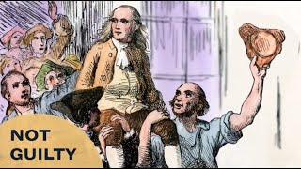
When is it fair and reasonable to limit free expression?
Courts have limited free speech:
  to protect the public’s safety from imminent threats
  to limit the time, place and manner (e.g no loudspeaker late at night in a residential neighborhood)
  national security
  libel and slander
  pornography
  commercial speech

Slide 56
What is fairness or justice?
Definition | Characteristics
Examples | Non-examples
Draw or find
an illustration
Notes:
let’s move onto the concept of fairness or justice.
Again, you could have your students think about and complete a Frayer chart about fairness or justice, especially by drawing examples.

Slide 57
What is fairness or justice?
Distributive justice: how we share
Corrective justice: how we correct a wrong or injury
Procedural justice: how we gather information and make decisions
Notes:
We can systematically address the concept of fairness or justice using Foundation of Democracy materials (show the Justice book).
ASK: What is fairness or justice?
The Foundations of Democracy materials identify three different types of justice:
Distributive justice: how we share
Corrective justice: how we correct a wrong or injury
Procedural justice: how we gather information and make decisions
We don’t usually break the concept of justice into its different applications and I think looking at justice through these different lenses is very useful. Let’s briefly look at each one.

Slide 58
Is distributive, corrective or procedural justice involved?
Your class has 12 color markers. There are 20 students who want to use them.
A student in your class cheats on a test.
The principal wants to find out who painted graffiti in the restrooms.
Your class has to decide how much each student should donate for a spring party.
The librarian has $2000 to spend on the school library. She has to decide whether to buy more books or a new computer.
During recess, a student in your class throws a ball and breaks a window.
Notes:
Here are some examples of the three types of justice. Let me know which one is involved: distributive (sharing), corrective or procedural? DO IT
1. Your class has 12 color markers. There are 20 students who want to use them. (This is a question of distributive justice or fair sharing)
2. A student in your class cheats on a test (This is a question of corrective justice or fair punishment)
3. The principal wants to find out who painted graffiti in the restrooms. (This is a question of procedural justice or how to fairly find out information and make a decision)
4. Your class has to decide how much each student should donate for a spring party. (Distributive)
5. The librarian has $2000 to spend on the school library. She has to decide whether to buy more books or a new computer. (Distributive and Procedural—how is she going to decide)
6. During recess, a student in your class throws a ball and breaks a window. (Corrective Justice)
You might ask your students for other examples.

Slide 59
Intellectual Tools for resolving issues of distributive justice (how to share)
What burden or benefit is to be distributed?
What persons should be considered to receive burden or benefit?
What are the similarities or differences in terms of
  Need
  Capacity
  Desert
Which similarities and differences should be taken into account in deciding?
What would be the fair way to distribute the benefit or burden?
Notes:
We have intellectual tools for distributive justice. We want to consider:
1. WHAT burden or benefit is to be distributed?
2. WHO—the persons considered to receive burden or benefit
3. WHAT are the Similarities or Differences among these people in terms of
Need—how much do the persons need what you are distributing?
E.g.: If you have enough cookies for 10 students and four students have not eaten all day. Who should get the cookies and why? Obviously the four hungry ones.
Capacity—ability—how well are the persons able to use what you are distributing?
E.g.: Six students want to work on the school newspaper. Two of the students write very well. Who should get the job and why?
Desert—How deserving are the persons who wish to receive what you are distributing?
E.g.,: One student worked hard on a science project. It was very good. Others did not work so hard. Who should get a prize for their science project? Why?
Ask: Which similarities and differences regarding need, capacity and desert should be taken into account in deciding?
5. And conclude: What would be the fair way to distribute the benefit or burden?

Slide 60
Distributive Justice: What would be the fair thing to do in each situation?
Your community has had a terrible fire. The Red Cross has a limited amount of food and clothing to help people. The fire did not hurt several families. It did destroy the home and property of many others.
You want to leave a group of five-year old children with a babysitter. The ages of your cousins are three, five and fourteen. They have each asked to babysit.
In your class, three students always interrupt others. They make it difficult to learn. Your teacher needs to decide who should receive poor grades in citizenship.
There is going to be an election to chose the president of the student council The second, third, fourth and fifth-grade students want the right to vote in the election.
Notes:
Here’s an activity for your students to use the concepts of need, capacity and desert to determine how to fairly distribute a benefit or burden. How would you decide what would be the fair thing to do? NEED, CAPACITY, or DESERT? DO IT
1: Your community has had a terrible fire. The Red Cross has a limited amount of food and clothing to help people. The fire destroyed the homes and property of some people but not everybody. (NEED)
2: You want to leave a group of five-year old children with a baby sitter. The ages of your cousins are three, five and fourteen. They have each asked to babysit. (CAPACITY)
3: In your class, three students always interrupt others. They make it difficult to learn. Your teacher needs to decide who should receive poor grades in citizenship. (DESERT)
Group 4: There is going to be an election to chose the president of the student council The second, third, fourth and fifth-grade students want the right to vote in the election. (CAPACITY)

Slide 61
Intellectual Tools for Solving Problems of Corrective Justice
What are the wrongs or injuries?
How serious are the wrongs and injuries?
Who caused the wrongs or injuries?
  Did the person intend to do wrong or cause an injury or was it accidental?
  Did the person have the ability to know that his or her actions were wrong or might cause injury?
  Did the person know what would happen but he or she decided to act anyway?
  Did the person fail to notice or pay attention to the possible risks?
  Has the person done similar wrong or caused similar injuries in the past?
  Is the person sorry for what he or she did?
  If the person did not act alone, what part did he or she play?
Who suffered the wrongs or injuries?
Notes:
Intellectual Tools for Corrective Justice asks:
What are the wrongs or injuries?
How serious are the wrongs and injuries?
Who caused the wrongs or injuries?
Did the person intend to do wrong or cause an injury or was it accidental?
Did the person have the ability to know that his or her actions were wrong or might cause injury?
Did the person know what would happen but he or she decided to act anyway?
Did the person fail to notice or pay attention to the possible risks?
Has the person done similar wrong or caused similar injuries in the past?
Is the person sorry for what he or she did?
If the person did not act alone, what part did he or she play?
Basically, state of mind (intentional or accidental); first time or repeat offender, personal response (remorseful?) and whether others were also involved.

Slide 62
Corrective Justice: Addressing wrongs and injuries
Are these wrongs (intentional) or injuries (accidents)?
Three teenagers assaulted Mrs. Samuels. They stole her purse. Mrs. Samuels broke her arm in the fall.
Jake extorted money from Ryan.
Juliet dropped Paula’s pot. The pot broke into several pieces.
Give examples from your life that involved:
  Both a wrong and an injury
  Only a wrong
  Only an injury
Notes:
Let’s apply the tools to some situations where we want to address wrongs and injuries. Basically, deciding what punishment fits the crime, so to speak.
Are these wrongs or injuries (accidents)?
Three teenagers assaulted Mrs. Samuels. They stole her purse. Mrs. Samuels broke her arm in the fall. (INJURY--stealing AND WRONG--accidental)
Jake extorted money (through force or threats) from Ryan. (INJURY AND WRONG)
Juliet dropped Paula’s pot. The pot broke into several pieces. (INJURY BUT NOT INTENIONAL)
ASK: Why is the difference important?
An injury is intentional (like a crime) and needs to be punished.
An accident (without intent) is not the same unless it was foreseeable.

Slide 63
Procedural Justice/Due Process
Procedural Justice refers to the fairness of the process used to gather information and make decisions.
Police often need information about people they think have broken the law. How they get this information is important.
Courts have procedures for gathering information, presenting information (witnesses, judge, jury) and making decisions that include:
Local school boards, city councils, the president of the United States and Congress all need to gather information and make decisions, using fair procedures.
Procedural justice is important because it:
  increases the chances of getting the information needed to make wise and fair decisions
  ensures the wise and fair use of the information in making decisions
  protects important individual rights, such as freedom, liberty and dignity
Notes:
Probably the most important part of fairness or justice is having fair processes, often called “procedural justice” or “due process.” Procedural Justice refers to the fairness of the process used to gather information and make decisions.
Police often need information about people they think have broken the law. How they get this information is important. Courts have procedures for gathering information, presenting information and making decisions that include:
the right to tell your side of the story
the right to have a lawyer
the right to have witnesses who support you
the right to question witnesses who testify against you
the right to an impartial judge and jury
Local school boards, city councils, the president of the United States and Congress all need to gather information and make decisions, using fair procedures.
Procedural justice is important because it:
increases the chances of getting the information needed to make wise and fair decisions
ensures the wise and fair use of the information in making decisions.
Protects important individual rights, such as freedom, liberty and dignity.

Slide 64
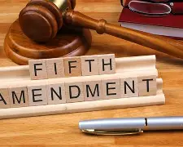
Fifth Amendment
“No Person shall…be deprived of life, liberty, or property, without due process of law.”
Notes:
Procedural justice is based on the Fifth Amendment which requires that “No Person shall…be deprived of life, liberty, or property, without due process of law.”
Let’s look at what “due process of law” means…

Slide 65
Identify the procedural justice issue in each of these situations
Rosie thought someone in the class had taken her radio. During recess while everybody was on the playground, Rosie went back into the classroom and searched every desk.
This is not procedural justice. Student desks cannot be secretly searched. And Rosie is not an appropriate authority to search desks.
Mr. Tsu, the principal, knew that several boys were in the library this morning and they left a terrible mess. He called four students to his office and questioned each one. Three admitted that they had been in the library and had made a mess. The fourth boy was afraid to answer. The principal kept him after school until he gave a response and admitted that he had helped to make the mess in the library.
This not procedural justice. Students cannot be threatened with punishment as a means to obtain information.
The police arrested Jed for kidnapping. Jed’s lawyer asked for a trial by jury. Twelve jurors had to be chosen from a group of 100 people. Jed’s lawyer had the right to questions each person. She could refuse to accept people she thought might be prejudiced against Jed.
This is part of procedural justice. The lawyer for a defendant in a criminal case has the right to question the potential jurors to eliminate people who might be prejudiced against the defendant.
Notes:
Let’s consider whether procedural justice was followed in each of these situations: DO IT
1. Rosie thought someone in the class had taken her radio. During recess while everybody was on the playground, Rosie went back into the classroom and searched every desk.
This is not procedural justice. Student desks cannot be secretly searched. And Rosie is not an appropriate authority to search desks.
2. Mr. Tsu, the principal, knew that several boys were in the library this morning and they left a terrible mess. He called four students to his office and questioned each one. Three admitted that they had been in the library and had made a mess. The fourth boy was afraid to answer. The principal kept him after school until he gave a response and admitted that he had helped to make the mess in the library.
This not procedural justice. Students cannot be threatened with punishment as a means to obtain a response.
3. The police arrested Jed for kidnapping. Jed’s lawyer asked for a trial by jury. Twelve jurors had to be chosen from a group of 100 people. Jed’s lawyer had the right to questions each person. She could refuse to accept people she thought might be prejudiced against Jed.
This is part of procedural justice. The lawyer for a defendant in a criminal case has the right to question the potential jurors to eliminate people who might be prejudiced against the defendant.

Slide 66
What are fair procedures?
Notice and a Hearing
Extent of “due process” depends on the extent of the right involved:
  If you may potentially lose your liberty and go to jail, your procedural due process is much greater than if you are a student who has been suspended for a day because of getting into a fight.
  A potential jail term would require a lawyer, a trial, and the opportunity to cross examine.
  A potential school suspension would require notice and a hearing.
6.1.5.CivicsPR.1: Compare procedures for making decisions in a variety of settings including classroom, school, government, and /or society.
Notes:
So, at the core, what are fair procedures? In balancing the rights of the individual and the right of society to be safe, the potential severity of the consequences is considered. For example:
If you may potentially lose your liberty and go to jail, your procedural due process is much greater than if you are a student who has been suspended for a day because of getting into a fight.
A potential jail term would require a lawyer, a trial, and the opportunity to cross examine.
A potential school suspension would require notice and a hearing.
At a minimum, a fair procedure requires notice and a hearing.

Slide 67
How do we make decisions in a democracy?
We elect representatives with the authority to make decisions for the community
They have a responsibility to make decisions for the common good that have a legitimate purpose, are clear, understandable and fair
Members of the community have the right to express their views
We share our views with each other and with those in authority
We respect, listen to and consider other views
We may form groups to lobby our elected representatives or assemble and protest
6.1.5.CivicsDP.1: Using evidence, explain how the core civics virtues and democratic principles impact the decisions made at the local, state and national government (e.g., fairness, equality, common good)
Notes:
Now we have some background and understanding of our government, why we need rules and authority, why we all have responsibilities. Let’s go back to the question of how we make decisions in a democracy.
We elect representatives with the authority to make decisions for the community
They have a responsibility to make decisions for the common good that have a legitimate purpose, are clear, understandable and fair
Members of the community have the right to express their views
We share our views with each other and with those in authority
We respect, listen to and consider other views
We may form groups to lobby our elected representatives or assemble and protest

Slide 68
The Right to Vote
“The Times, Places and Manner of holding Elections for Senators and Representatives shall be prescribed in each State…” Art. I, Sec. 4
There is no right to vote in the U.S. Constitution
The Constitution left the management of state and federal elections to the states, which:
  Set the hours and locations of polling places
  Determine how people may vote (mail-in ballots are only permitted in some states)
  Determine how people may register to vote (same day voting, ID cards, etc.)

Slide 69
The Right to Vote
The federal government has exercised some control over voting:
  14th Am. defined birthright citizenship (1868)
  15th Am. prohibited denial of vote “on account of race, color or previous condition of servitude”(1870)
  19th Am. prohibited denial of vote “on account of sex” (1920)
  24th Am. prohibited denial of vote “for failure to pay poll tax” (1964)
  26th Am. prohibited denial of vote to citizens 18 years of age or older (1971)
  Voting Rights Act of 1965 prohibited states from imposing qualifications or practices to deny the right to vote on account of race and permitted direct federal intervention in the electoral process and preclearance of new laws in state with history of restricting voting (not in Constitution, renewed by Congress)
Notes:
The federal government has exercised some control over voting to counteract the actions by some states to restrict voting by minority groups:
14th Am. defined birthright citizenship—anyone born in U.S. is a citizen entitled to rights of a citizen.
15th Am. prohibited denial of vote “on account of race, color or previous condition of servitude”(1870)
19th Am. prohibited denial of vote “on account of sex” (1920)
24th Am. prohibited denial of vote “for failure to pay poll tax” (1964)
26th Am. prohibited denial of vote to citizens 18 years of age or older (1971)
Voting Rights Act of 1965 prohibited states from imposing qualifications or practices to deny the right to vote on account of race and permitted direct federal intervention in the electoral process and preclearance of new laws in state with history of restricting voting (not in the Constitution—renewed by Congress, but could be changed)

Slide 70
The Right to Vote
The 2013 U.S. Supreme Court decision in Shelby County v. Holder (570 U.S. 529) eliminated the need for states with a history of discriminating in the past to obtain preclearance from the federal government before making changes in their voting procedures, such as places and times of voting, which might adversely affect minority groups.
Gerrymandering--manipulating the boundaries of an electoral district (esp. State Legislative and Congressional Districts) to favor one party or class—making elec­tions less compet­it­ive, in turn making voters feel like their votes don’t matter
Notes:
And that is what happened the last few years:
In 2013, the U.S. Supreme Court decision in Shelby County v. Holder (570 U.S. 529) eliminated the need for states that had discriminated in the past to obtain preclearance from the federal government before making changes in their voting procedures, such as places and times of voting, which might adversely affect minority groups.
So, several states then limited polling places, times and procedures.
They also engaged in gerrymandering, that is, manipulating the boundaries of an electoral district (esp. State Legislative and Congressional Districts) to favor one party or class—which makes elec­tions less compet­it­ive, in turn making voters feel like their votes don’t matter. We’ve seen this to the absolute extreme in Texas, California, and elsewhere with states redistricting in between the census.

Slide 71

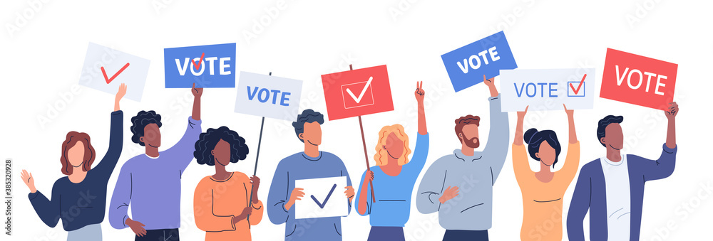
NJ Center for Civic Education, NJSSSA and NJCSS sponsor a NJ Student Mock Election each fall to help students get in the habit of being informed voters
Includes teacher resources and links to sources of information about candidates
Students can vote online or with paper ballot. Student privacy is protected. No personal information is collected.
Held the last two weeks of October each year
https://civiced.rutgers.edu/nj-student-mock-election/home
Notes:
All of these levels of government, from school boards to municipalities, counties, state governor an legislators, members of congress and president (but NOT the NJ or federal courts) require public elections. We are offered the opportunity every year to select who we want to represent us.
Often, when there are only candidates running for municipal, county and the state legislature on the ballot, turn out is very low. This is unfortunate. Evidently people do not appreciate how much state and local government influences their lives.
The Center, the NJ Social Studies Supervisors Association and the NJ Council for the Social Studies offer an opportunity each year for you to involve your students grades 4-12 in a mock election so that they can practice the HABIT of informed voting in every election. The NJ Student Mock Election takes place the last two weeks of October before the actual election in November. Has anybody participated?
It is easy to do. And no information about your students is taken. It happens every year the last two weeks of October before the November election. We hope that you might participate in the future.

Slide 72
What is responsibility?
Definition Something that you should do or a way you should behave or something that you should not do or a way you should not behave | Characteristics
Examples | Non-examples
Draw or find
an illustration
Notes:
Let’s turn to the concept of responsibility. What is it? It is more than something we should do. It is also the way we should behave. And it involves things we should NOT do. Responsibility also means that we ought to ACT in a certain way. Some examples might be respecting the feelings of others or telling the truth.
Can you give me some other examples?
You might ask your students for some examples, like doing homework, cleaning their room, putting toys away, feeding a pet, or other chores assigned by a parent or teacher.
Again, your K-2 students might be asked to draw examples.
Understanding why we have responsibilities and how we get them helps children to develop positive civic attitudes or dispositions…

Slide 73
How do we get responsibilities?
Promises
Our job or position gives us things we ought to do (police, teachers, parents)
People with authority tell us things we ought to do or something we should not do
We have rules that we ought to follow
We have beliefs about right and wrong ways to act
Notes:
Ok, so Responsibility is a duty. It is something we ought to do. How do we get responsibilities?
We get responsibilities by:
making promises,
other people telling us what to do,
our job,
rules that we should follow or
beliefs about what’s right and wrong.
Similar to how we get authority…

Slide 74
What are some benefits and costs of a responsibility?
When you carry out your responsibilities, good things happen. For example, when you do your homework, you learn and you feel proud of your work.
When you don’t carry out your responsibilities, other things happen. For example, if you don’t do your homework, you don’t learn. You don’t feel proud about yourself.
Notes:
What are some benefits and costs of a responsibility?
When you carry out your responsibilities, good things happen. When you do your homework, you learn and you feel proud of your work.
But, when you don’t carry out your responsibilities, other things happen. You don’t learn. You don’t feel proud about yourself.
Pretty simple. Pretty basic. Pretty important—even at the kindergarten level!

Slide 75
Harriet Tubman’s Responsibilities
Harriet Tubman was born into slavery in Maryland before the Civil War but escaped. She believed that slavery was wrong.
She became a “conductor” on the Underground Railroad, making more than 13 trips into the Deep South to bring more than 70 (some say 300) slaves to freedom in the North.
Some believed that she was an outlaw and there was a reward for her capture and arrest.
What were Harriet Tubman’s responsibilities and where did they come from?
What were the costs and benefits for herself and others of carrying out these responsibilities?
Which costs and benefits do you think were most important and why?
Would you have done what Harriet Tubman did? Why or why not?
Notes:
There’s a wonderful little lesson in Foundations of Democracy about responsibility featuring Harriet Tubman, who was born into slavery in Maryland before the Civil War but escaped. Tubman became a “conductor” on the Underground Railroad, making more than 13 trips into the Deep South to bring more than 70 (some say 300) slaves to freedom in the North. Some believed that she was an outlaw and there was a reward for her capture and arrest.
In addition to a great history lesson about an exceedingly brave woman, Tubman’s story let’s children consider the costs and benefits of the responsibilities that she undertook.
What were the costs and benefits for herself and others of carrying out these responsibilities?
Which costs and benefits do you think were most important and why?
Would you have done what Harriet Tubman did? Why or why not?
This also connects civics with the Amistad and Holocaust mandates.

Slide 76
Responsibilities of a public position and Civic Virtue
Responsibilities of executives (president, governor, mayor), legislative bodies (Congress, NJ State Legislature, town councils, school boards) and courts are established by law
Leaders have an obligation to make fair decisions following due process (fair procedures)
Civic virtue: putting the good of the community (the common good) ahead of your own personal or political interests
What would be an example of civic virtue: George Washington. Why? Other examples?
Why is civic virtue important in a democracy?
6.1.2.CivicsCM.1: Describe why it is important that individuals assume personal and civic responsibilities in a democratic society.
6.1.2.CivicsCM.2: Use examples from a variety of sources to describe how certain characteristics can help individuals collaborate and solve problems (e.g., open-mindedness, compassion, civility, persistence).
6.1.2.CivicsPR.3: Analyze classroom rules and routines and describe how they are designed to benefit the common good.
Notes:
Those people in positions of AUTHORITY have certain RESPONSIBILITIES because of their positions.
Leaders have an obligation to make fair decisions following due process (fair procedures)
I want to consider the concept of Civic virtue: basically putting the good of the community (the common good) ahead of your own personal or political interests
What would be an example of civic virtue: George Washington
Why? Other examples?
ASK: Why is civic virtue important in a democracy?

Slide 77
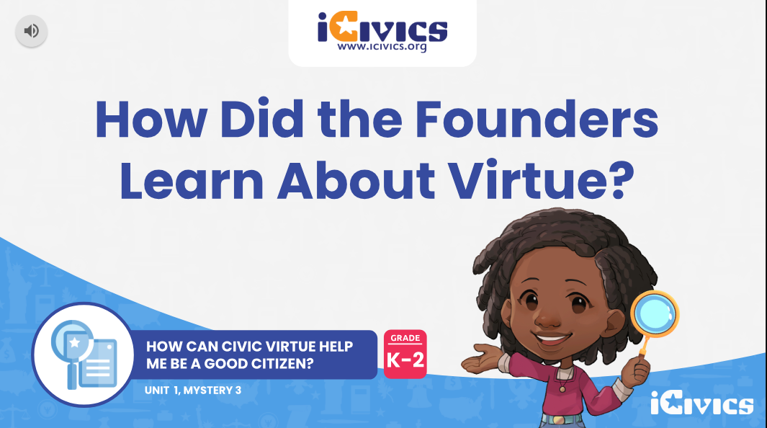
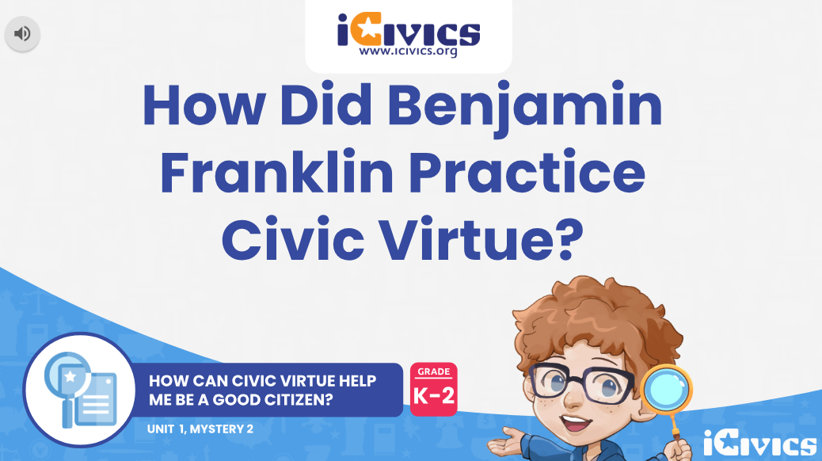
iCivics Lessons about
Civic Virtue - K-2
How Did the Founders Learn About Civic Virtue? | iCivics
How Did Benjamin Franklin Practice Civic Virtue? | iCivics
Each lesson:
Merges definitions of “virtue” and “civic” to understand civic virtue;
Asserts that civic virtue requires action and practice;
Explains that the Founding Generation practiced the virtues of -
1) Perseverance, 2) Moderation, 3) Prudence, 4) Generosity, 5) Courage;
Relates those Founding Virtues to Student Virtue and Classroom Rules.

Slide 78
How do we decide who is responsible?
Why do we want to know who was responsible for something that happened?
We want people to act responsibly.
We reward people for doing good things (reduction in your insurance) and penalize than for acting irresponsibly (e.g., an oil spill, a train accident, etc.)
What ideas might be useful in deciding who is responsible?
Notes:
Another important question about responsibility arises when something goes wrong and we want to determine WHO is responsible?
Why do we want to know who was responsible for something that happened?
We want people to act responsibly.
We reward people for doing good things (reduction in your insurance) and penalize than for acting irresponsibly (e.g., an oil spill, a train accident, etc.)
So, what ideas might be useful in deciding who is responsible?

Slide 79
Intellectual Tool Chart: Responsibility
What is the event or situation?
Who are the persons who might be considered responsible?
How might each person be considered to have caused the situation?
What was the person’s state of mind? Intent? Carelessness? Knowledge or what might happen?
Did the person lack control?
Did the person have a duty to act differently?
What important values or interests, if any, help explain the persons’ behavior?
Who do you think is responsible for this event or situation? Why?
Notes:
The Foundations of Democracy materials utilize intellectual tool charts to understand responsibility. In determining who is responsible for an event, they ask your students to CONSIDER:
WHAT is the event or situation?
WHO are the persons who might be considered responsible?
HOW might each person be considered to have CAUSED the situation?
What was the person’s state of mind? Intent? Carelessness? Knowledge o what might happen?
Did the person lack control?
Did the person have a duty to act differently?
What important values or interests, if any, help explain the persons’ behavior?
And then to conclude: Who do you think is responsible for this event or situation? Why?
.

Slide 80

Who is responsible for the environment?
We are all responsible for the environment!
Notes:
Another civics lesson from Dr. Seuss: The Lorax. It asks about our responsibility for damaging the environment. It is also available as a video—but you need to get the original one. READ:
The Lorax tells the story to a young boy about how the Onceler found beautiful truffala trees and started to cut them down until he had cut them all down, polluting the air and the water in the process.
The Barbaloot Bears no longer had no truffula fruit to eat, the Humming Fish couldn’t sing with the polluted air and the Swomee-Swans couldn’t swim in the polluted water. The Lorax came to speak for the trees and tells the boy:”unless someone like you care a whole awful lot, nothing is going to get better. It’s not”
For K-2 there are finger puppets! You might ask your students for various ways in which we can protect the environment.
You can inquire if we have any laws to protect the environment? Or if we have any governmental agencies designed to protect the environment? Do we? What would it be? They might answer—with or without some prodding—the EPA (Environmental Protection Agency) or DEP (The NJ Dept. of Environmental Protection)

Slide 81
Directions for a Hearing with the Lorax
Count off by sixes and assign the following roles:
  1s = The Lorax
  2s = Brown Bar-ba-loots
  3s = Humming Fish
  4s = Swomee-Swans
  5s = The Once-ler
  6s = The EPA Commissioners
Prepare for the hearing:
The witnesses (everyone but the EPA commissioners) prepare a statement from the perspective of its members:
  A statement of the problem
  Details about how the group has been injured
  A request for some relief or improvement of the situation
The EPA Commissioner prepare questions to ask the injured parties and select a chief commissioner.
Notes:
One possibility is to hold hearing about the damage the Once-ler has done to the environment. I did this with a third grade class in Westfield and it was a lot of fun and we had a great discussion. The directions are included online. Have students count off by sixes and assign the following roles:
1s = The Lorax
2s = Brown Bar-ba-loots
3s = Humming Fish
4s = Swomee-Swans
5s = The Once-ler
6s = The EPA Commissioners
Prepare for the hearing:The witnesses (everyone but the EPA commissioners) prepare a statement from the perspective of its members:
A statement of the problem
Details about how the group has been injured
A request for some relief or improvement of the situation
The EPA Commissioner prepare questions to ask the injured parties and select a chief commissioner.
Afterwards, look at all of the possible solutions and, going back to our ideas about what makes a good rule, evaluate whether they are fair, clear and workable. The Lorax, who wants to protect the environment, suggests to the boy at the end of the book that we are ALL responsible for the environment.

Slide 82
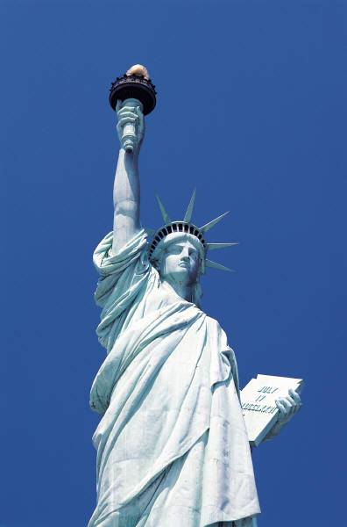
Who is a citizen of the United States?
A citizen is someone who was born in the U.S. or born to U.S. parents
Resident aliens is the term used for immigrants not born in the U.S. or the U.S, parents but are living in the U.S.
How do immigrants who are resident aliens become naturalized citizens?
  Must be at least 18 years old
  Lawfully admitted to the U.S. for permanent residence
  Have resided continuously in the U.S. for at least five years
  Have photos and fingerprints taken
  pay a fee and take a citizenship exam and
  take an oath of allegiance at a public ceremony
6.1.5.CivicsPR.2: Describe the process by which immigrants can become U.S. citizens
Notes:
We keep saying that the goal of teaching civics is to have informed, engaged citizens. Who is a citizen? This is pretty straightforward:
Someone born in the U.S. or to parents born in the U.S. OR
Someone who was born elsewhere but is at least 18 years old, was lawfully admitted to the US, has resided in the US for at least five years and has become a naturalized citizen by passing a test on the Constitution and history of the United States.
Resident aliens live here but have not become naturalized citizens.
4. How do immigrants who are resident aliens become naturalized citizens? You must be:
at least 18 years old
Lawfully admitted to the U.S. for permanent residence
Have resided continuously in the U.S. for at least five years
Have photos and fingerprints taken
pay a fee and take a citizenship exam and
take an oath of allegiance at a public ceremony

Slide 83
What are the responsibilities of citizenship?
Obey the law
Pay taxes
Serve on a jury when called
Vote (but only half the population does this in most given elections)
Hold our elected representatives accountable
Anything else?
Notes:
What responsibilities go along with the rights of being a citizen:
You must:
Obey the laws
Pay taxes
Serve on a jury when called
Vote
Hold elected representatives accountable.
Anything else? Any other responsibilities citizenship should have? We never seem to ask questions like this. And asking them when our students are young is the way to instill positive dispositions about what citizens should do.

Slide 84



Children’s Literature - Civic Virtue and Civic Mindedness
“What Can a Citizen Do?” explores how kids turn a lonely island into a community—and watch a journey from what the world should be to what the world could be.This is a book about what citizenship—good citizenship—means to you, and to us all. (For ages 1-12)
What if everybody broke the rules…and spoke during story time, didn’t wash up, or splashed too much at the pool? Then the world would be a mess. But what if everybody obeyed the rules so that the world could become a better place? (For ages 3-7)
“Be a Good Citizen” helps children understand law as a code of conduct, as well as the foundation for exercising individual rights and responsibilities as citizens to improve their communities and country. (3 book series for ages 6-12)

Slide 85
We the People: The Citizen and the Constitution
Initiated in 1987 as part of the bicentennial of the Constitution.
Materials for upper elementary, middle and high school classes, updated every decade.
Repeatedly subjected to independent evaluations, which showed that participating students:
made significantly greater gains than comparison students in their understanding of core values and principles of democracy, constitutional limits on governmental institutions, and rights and responsibilities of citizenship
improved their civic skills, including their ability to analyze issues, debate, persuade, and achieve group consensus
“significantly outperformed comparison students” on civics tests, displayed greater political tolerance, and were more likely to vote

Slide 86
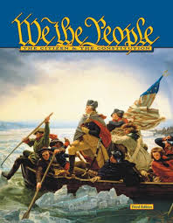
We the People: The Citizen
and the Constitution
Unit 1: What Basic Ideas About Government Did The Founders Have?
Unit 2: How Did The Framers Write Our Constitution?
Unit 3: How Does The Constitution Organize Our Government?
Unit 4: How Does The Constitution Protect Our Basic Rights?
Unit 5: What Are the Responsibilities of Citizens

Slide 87
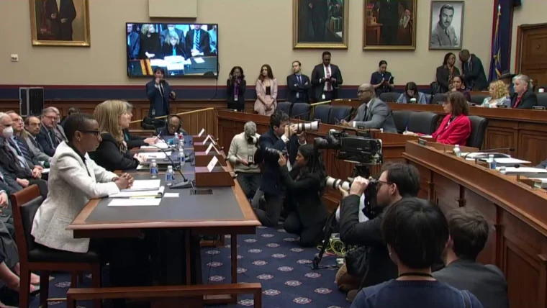
Simulated Congressional or Legislative Hearings
The culminating activity for We the People is a simulated legislative hearing. Students act as experts and “testify” before a simulated congressional committee on issues relating to the Constitution or current controversial topics. After the students’ “testimony”, a panel asks follow-up questions and offers constructive feedback.
Notes:
Another way that you can use the background about free expression and about the responsibilities of citizens is by involving your students in a simulated legislative hearing. One of the classroom strategies involving students in democratic practices that I really like is a simulated legislative or congressional hearing.
Students act as constitutional or policy experts and testify before a State Legislative or Congressional Committee on issues relating to the Constitution or a current controversial topic.

Slide 88
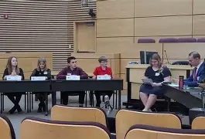
Simulated Congressional or Legislative Hearings
Orally present an opening statement (4 minutes max.)
Respond to questioning by judge panel (6 minutes max.)
Constructive feedback offered by panel
Notes:
The structure of the simulated legislative hearing is pretty clear.
Students “testify” as experts in their area of Constitutional law in an opening statement that is a maximum of 4 minutes running time.
Students then field questions from a “congressional committee” for a running time of 6-8 minutes running time

Slide 89
Level 1 We the People Hearing Question - Unit 4
Congress has formed a congressional committee to examine the peoples’ rights. They want to know how well they are being protected and what might be done. As expert witnesses, you will be asked to testify on the following questions:
What is freedom of expression, and why is it important to our democracy?
How does the Constitution protect freedom of expression?
Are there times when freedom of expression should be limited? Why or why not? Give examples.
Notes:
The We the People Teacher’s Guide includes a series of questions that you might use with your upper elementary students
Here is the one about free speech and half of you will work on this. HAND IT OUT.

Slide 90
Level 1 We the People Hearing Question - Unit 5
Congress has formed a congressional committee to examine the peoples’ rights. They want to know how well they are being protected and what might be done. As expert witnesses, you will be asked to testify on the following questions:
What responsibilities go along with the rights of citizens?
Do you think every citizen should be required to participate in his/her government? How?
How does a responsible citizen promote the common good?
Notes:
Here’s another series of question about the responsibilities of citizenship. Half of you will work on this topic. (HAND IT OUT)

Slide 91
How Can You Prepare Your
Students for a Simulated Hearing?
In unit groups of 3-6:
Consider the question - does it ask for evidence, analysis, and/or reasoned opinion?
Collaborate to develop a 4-minute opening statement for oral presentation.
Prepare for a 6-minute follow-up Q&A that goes beyond the opening statement.
Today we will model this process with you. In two groups, you will develop 2 minute opening statements, and prepare for 4 minute follow-up Q&A sessions – followed by two separate hearings.
Notes:
PREPARATION: How Can You Prepare your students for a Simulated Hearing? In your groups:
First step is to take time to consider the questions.
After carefully looking at the questions and delegating primary responsibility for each part of the question.
Then you will creatively and collaboratively prepare for potential questions from the panel – which will be Arlene and you
You have until 12:45 to prepare. You can use the background we wprovided today and the information in the shared folder to help you prepares. Craig will advise one team and I will advise the other.
We will finish today actually doing a simulated Congressional Hearing with each group responding to their unit question and, if time, some follow-up questions from Arlene and myself.

Slide 92
Simulated Congressional or Legislative Hearings
Read the Question
Orally present an opening statement (2 minutes max.)
Respond to questioning by judge panel (4 minutes max.)
Constructive feedback offered by panel

Slide 93
What is the role of a member of a community in a classroom? Of a citizen in a democratic society?
How does a responsible citizen promote the common good?
For K-2:
  How Can Generosity Help Me Be a Good Citizen? | iCivics
  How Do People Practice Being Civic-Minded? | iCivics
  How Can Civic Virtue Help Me Be a Good Citizen? | iCivics
  How Are Clara Barton and the Red Cross Civic-Minded? | iCivics
Why is it necessary that a citizen balances his or her self-interest with the common good?
Does a good citizen have a responsibility to try to improve the lives of people who need help? Why or why not?
How can you contribute to the common good of your school, family, neighborhood, town, state or country?
Notes:
How does a responsible citizen promote the common good?(Sort of back to where we started but now we’re so much more well informed—focus again on the civic attitudes or dispositions) Look at some of the iCivics
Should each citizen balance his or her self-interest with the common good?
For example, paying taxes is a way to fund what can only be done by government for the benefit of everybody, e.g. roads and schools.
Does a good citizen have a responsibility to try to improve the lives of people who need help? Why is it necessary that a citizen balance his or her self-interest with the common good?
We live together as a community. Citizens working together for the common good is sometimes the only way to make change to improve our lives.
Again, some very nice videos for K-2 Click and look at one of them
.

Slide 94
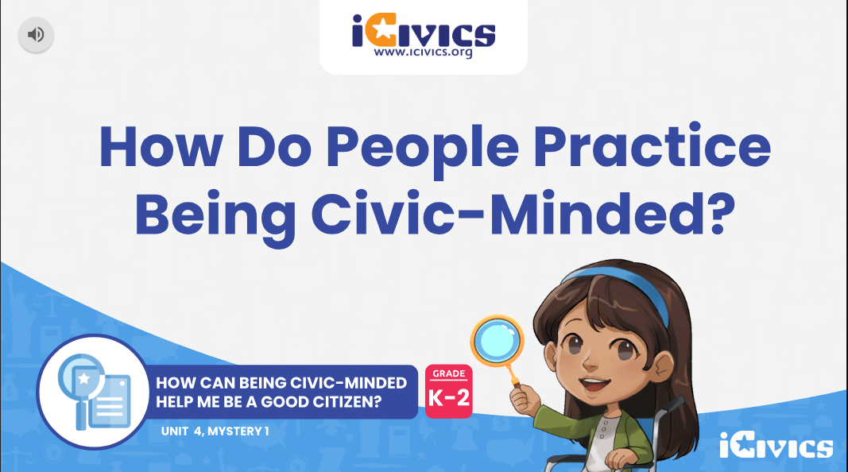
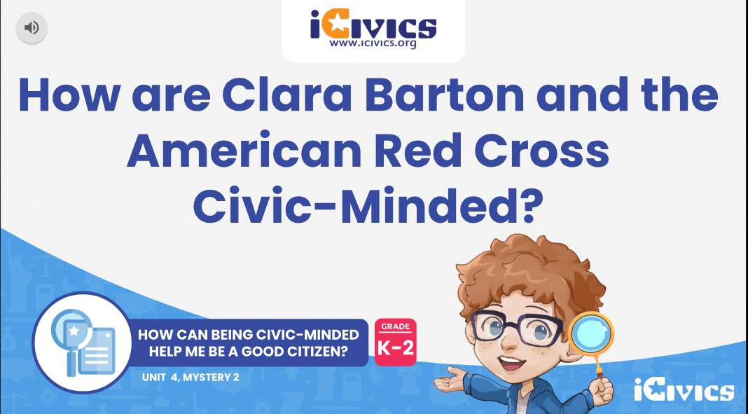
iCivics Lessons about being
Civic Minded & the Common Good
How Do People Practice Being Civic-Minded? | iCivics
How Are Clara Barton and the Red Cross Civic-Minded? | iCivics
Each lesson:
Defines the condition of being civic-minded -
Considers ways to help your community and the people in it;
Identifies four ways to be civic-minded -
1) Seek the common good, 2) Learn more, 3) Solve problems, 4) Help out;
Defines the common good and identifies examples of each way.

Slide 95
The common good: How can you improve your community?
The First Amendment right to petition was for citizens not lobbyists and we the citizens should be holding our elected officials accountable for their actions through letters, emails and petition.
“Ask not what your country can do for you; ask what you can do for your country.”
Identify a problem in your community that you would like to solve and bring it to the attention of the appropriate governmental entity/individual
6.1.5.CivicsCM6: Cite evidence from a variety of sources to describe how a democracy depends upon and responds to individuals’ participation.
Notes:
How can YOU improve your community?
You might also ask your students to give examples of people who have contributed to the common good and how? We’ve already considered historical figures such as George Washington, or Abraham Lincoln or Martin Luther King, Jr. But how about people who have helped locally contributed to the common good of the community.
Then ask your students how they can contribute to the common good of the school, family, neighborhood or town? (Maybe, follow rules, speak up when there is a problem. Vote or run for office when old enough. And maybe even urge their parents to vote!)
Consider JFK inaugural address, where he said: “Ask not what your country can do for you, ask what you can do for your country? EAD at https://www.educatingforamericandemocracy.org/educator-resources/?sword=&grade-level[]=230#popup-ead-post-7806
The First Amendment right to petition was written for citizens not lobbyists and we the citizens should be holding our elected officials accountable for their actions through letters, emails and petitions.

Slide 96

Project Citizen is a public-policy, process-based program to help students grades 3-12 learn about the political process and to develop a commitment to active citizenship
Provides the knowledge and skills required for effective citizenship participation
Involves students in learning about and improving their communities
Develops an understanding of the importance of citizenship participation
Full-day Project Citizen workshop Dec. 9, 2025
6.3.8.CivicsPD 1, 6.3.8,CivicsDP.1, 6.3.8.CivicsPR.4, 6.3.8.CivicsPR.6

Slide 97

Understand public policy
Identify possible problems for class study
Select a problem or problems
Gather information
Develop possible alternative solutions
Select the best solution
Develop an action plan
Develop a portfolio to present your plan
Present the project
Reflect on the experience
Notes:
The value of Project Citizen is that it provides a structure and framework to help you the teacher lead your class through a project. These are the basic steps:
1. Understand public policy
2. Identify possible problems for class study
3. Select a problem or problems
4. Gather information
5. Develop possible alternative solutions
6. Select the best solution
7. Develop an action plan
8. Develop a portfolio to present your plan
9. Present the project
10. Reflect on the experience

Slide 98
Will help your students understand public policy and the role of the citizen
Will improve your students research, critical thinking, collaboration, writing and presentation skills
The role of a citizen in a democratic society is not just voting but also bringing issues and offering ideas to your elected representatives and holding them responsible for their actions and decisions.
Annual Statewide Project Citizen Digital Showcase the first week of June. To register, email Craig Uplinger at cu88@scarletmail.Rutgers.edu
Notes:
Project Citizen
Will help your students understand public policy and the role of the citizen
Will improve your students research, critical thinking, collaboration, writing and presentation skills
The role of a citizen in a democratic society is not just voting but also bringing issues and offering ideas to your elected representative and holding them responsible for their actions and decisions.
The NJ Center for Civic Education sponsors an annual statewide Project Citizen Digital Showcase the first week of June.
Just send me an email if you are interested in having your class participate.

Slide 99
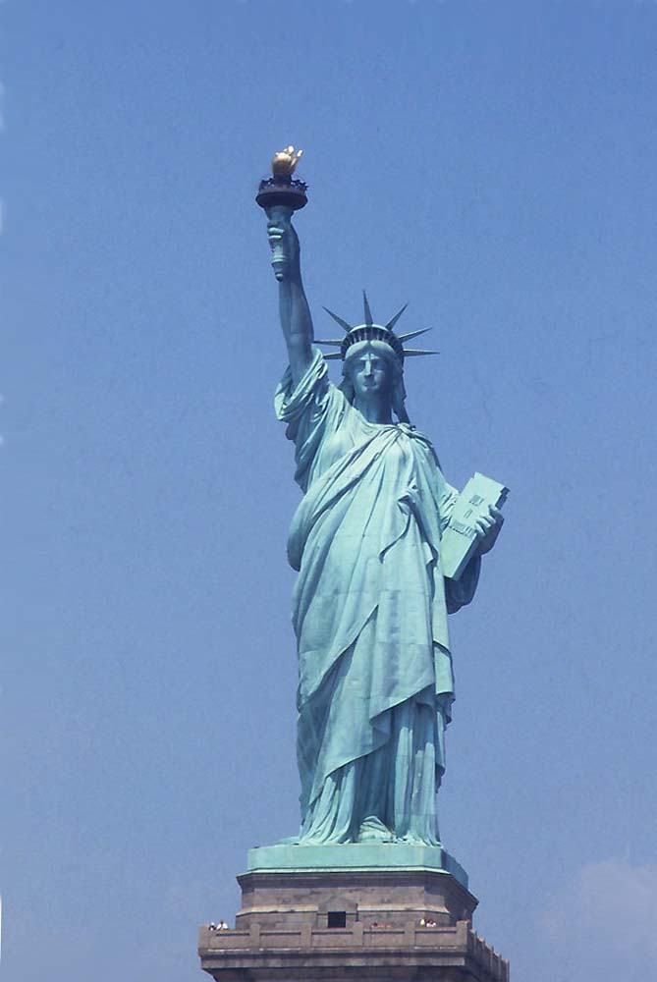

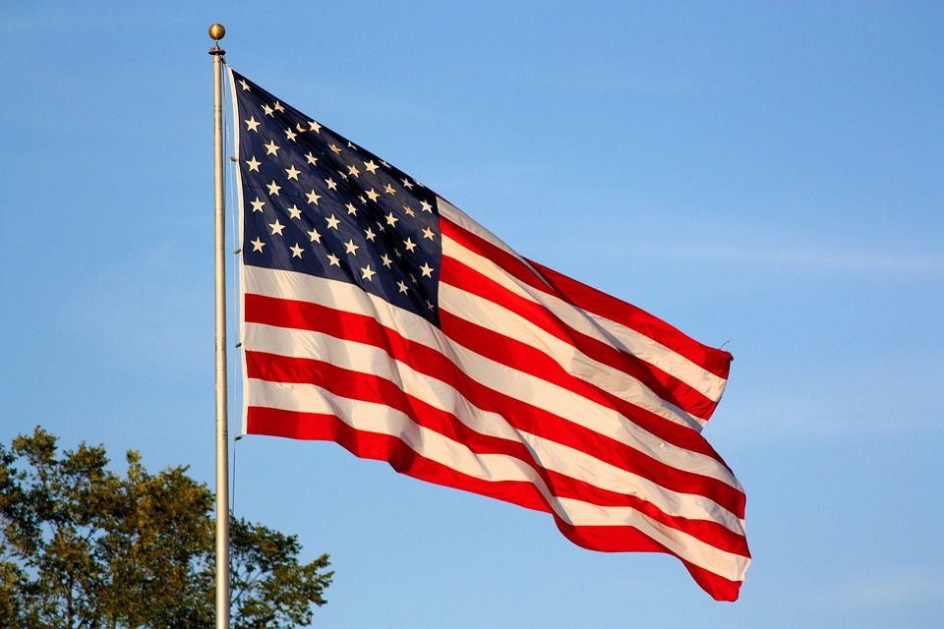
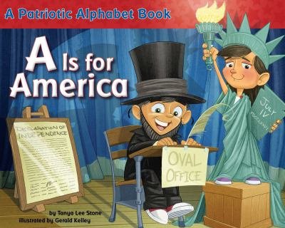
What do symbols say about our country?
Notes:
Let’s go back to some real basics—symbols and what they say about our country:
What does the Statue of Liberty stand for?
How abut the eagle? Courage, wisdom and strength
The American flag?
Kid Citizen Capture the flag: For K-2 students to investigate primary sources displaying the American flag to explore various ways people use the flag to show characteristics such as pride, loyalty and unity. EAD at https://www.educatingforamericandemocracy.org/educator-resources/?sword=&grade-level[]=229#popup-ead-post-7005

Slide 100
What are American Values?
Democracy
Limited Government
Rights
Responsibilities
Fairness
Rule of Law
Diversity
Equality
Opportunity
Freedom
Notes:
So one way to conclude your grade 3-5 civics class (along with having students do a project) might be to ask what American values are?
What would you suggest are core American values? DO IT
Click and show:
Democracy, Limited Government, Rights, Responsibilities, Fairness
Then discuss the possibility that if we look at our history, students might also consider:
Rule of Law, Diversity, Equality, Opportunity, Freedom
EAD: 9/11 and fundamental American values at https://www.educatingforamericandemocracy.org/educator-resources/?sword=&grade-level[]=230#popup-ead-post-7836
Also heading into the 250th anniversary of the Declaration of Independence, “What does America Mean to You?” Essay or Art Contest for Grades 3-12. Deadline: April 16, 2025 at https://america250.org/fieldtrip UPDATE

Slide 101
Core Civics Concepts
How do citizens, civic ideals, and government institutions interact to balance the needs of individuals and the common good?
Community
Common Good
Rules and Laws
Authority/Government
Responsibility
Rights/Fairness
Decision-making
The role of the citizen
American Values
Notes:
So we’ve now looked at many ideas and resources for teaching about these nine core civics concepts. Let’s look at some additional resources that exist…

Slide 102
K-5 Civic Toolkit: Foundations of Democracy
Foundations Of Democracy — RevNJ.org
From the NJ Dept. of Education
“A comprehensive K-5 civics toolkit empowering educators to shape tomorrow’s citizens through democracy, responsibility, and community.”
Focused on democratic classroom
Aligned with the 2020 New Jersey Student Learning Standards
Notes:
The NJ Dept. of Education has put together a K-5 Civic Toolkit aligned with the 2020 NJ Student Learning Standards.
Let’s take a look at it…

Slide 103
New Jersey History and Government Lessons
Grades K-2:
New Jersey’s Geography
New Jersey Symbols
New Jersey’s 21 Counties
Grades 3-5:
What Happened to the Lenni Lenape?
Colonial Immigration to NJ
How Did NJ become a British colony?
Colonial Life in New Jersey
Across the Curriculum with Lighthouses
Was New Jersey the Crossroads of the American Revolution?
Great Falls: Water, Power and Industrialization
Canal Transportation in NJ
Grades 3-5 (cont.):
Slavery and the Underground Railroad in New Jersey
New Jersey’s Railroads
New Jersey Silk Industry and Child Labor
Immigration in New Jersey
National, State and Local Government
Who Can Be Governor of NJ?
Who Represents You in Trenton?
New Jersey's Judiciary
A Mock Trial in New Jersey
New Jersey’s Local Government
New Jersey Women You Should Know
Improving Your Community
Notes:
We’ve already mentioned that we have lessons about NJ history and government on our website https://civiced.Rutgers.edu/nj-lessons (go to it)
As part of the celebration of the 350th anniversary of the founding on New Jersey in 1664 (when the British won the war against the Dutch and gained the land between the Hudson and the Delaware), the New Jersey Center for Civic Education received a small grant from the New Jersey Historical Commission to collect, create and disseminate classroom lessons about the people, places and events that shaped the development of the state, and to place historical events and sites in New Jersey into the broader context of United States and world history.
There are 23 lessons for elementary grades and a few more in the works. The lessons were developed by the Center with the help of several dozen NJ teachers. They include a series of lessons about NJ state and local government, including the legislature, the courts and the governor; and activities, such as legislative hearings, city council meetings, mock trials and moot courts. There are also activities regarding NJ history and geography—from Lighthouses, Canals, and Railroads to the Underground Railroad and Immigration, which might be quite useful for your class about New Jersey History (usually fourth grade).
Has anybody used any of these lessons? The website is currently being updated. Let’s look at a couple today. Which ones would you like to look at today?

Slide 104
Colonial New Jersey
Why immigrants decided to leave their homelands and settle in New Jersey?
Would you come to the North American colonies as an indentured servant? (economics)
Where did early immigrants come from and where did they settle and why? (map lesson)
What was colonial life like in the North American colonies?
How did life in the North American colonies differ from life in Europe?
Notes:
Several lessons with activities about colonial NJ, including suggestions to visit the many existing colonial sites in the state such as:
Marlpit in Monmouth County
The New Sweden Farmstead Museum in Bridgeton
The Robinson Plantation House, built around 1690 in Clark, Union County
The Dutch-style Steuben House, built in 1695, in River Edge, Bergen County
The British-style Hancock House, built in 1735, in Lower Alloways Ceek, Salem Count
The Cornelius Low House, a Georgian mansion built by a wealthy Dutch merchant in 1741, in Piscataway, Middlesex County.
The Vanderveer House, a Federal style home in 1779 in Bedminster Township, Somerset County.
We are so lucky to have so much history ON THE GROUND for students to SEE history firsthand.

Slide 105
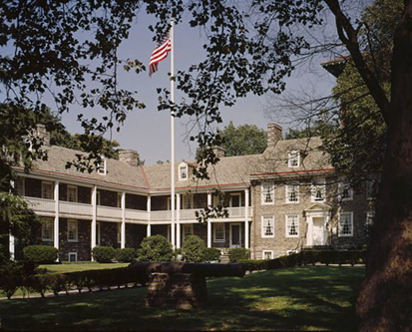
New Jersey: Crossroads of the American Revolution
See New Jersey and the American Revolution at https://civiced.rutgers.edu/njlessons.html
Meet Your Revolutionary Neighbors - Crossroads of the American Revolution
Notes:
And if you want to make the revolution more real for your students—you can look at it from the perspectives of residents who lived in NJ during the war:
There are several lessons about New Jersey and the American Revolution that also include videos about Molly Pitcher, the winter encampment in Morristown and Ten Crucial Days in NJ at our website at https://civiced.rutgers/edu/njlessons.html
Better yet, take your students to one of the many revolutionary war sites in NJ! Not every state is so laden with this history on the ground

Slide 106
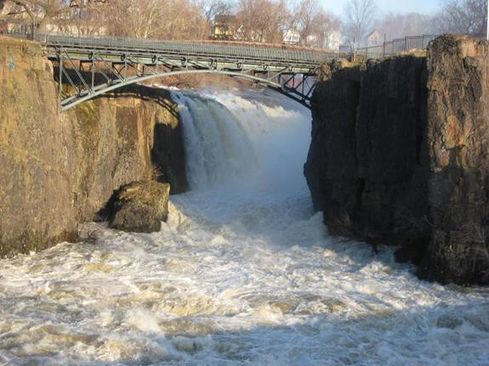
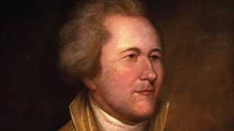
New Jersey: Powerhouse of Innovations and Economic Development
Great Falls, Paterson, NJ--First planned industrial site
https://civiced.rutgers.edu/documents/nj-lessons/for-grades-3-5/143-great-falls-water-power-and-industrialization/file
Alexander Hamilton
and New Jersey
Notes:
There are a series of lessons about Economic development in NJ, starting right after the American Revolution:
In 1792, Alexander Hamilton founded the "Society for the Establishment of Useful Manufactures," supported by private investors and chartered by NJ, and established the Great Falls on the Passaic River in NJ in 1791 as the first planned industrial city.
The water falls were harnessed as a power source for grist mills and resulted in the growth of Paterson (named after NJ’s first governor William Paterson) as one of the first industrial centers in the United States.
Hamilton hoped to demonstrate the ability of the U.S. to use its plentiful raw materials and its people's special aptitude for technological pursuits through successfully manufacturing.
Critical thinking activity: Ask students to look at a map of the eastern United States and explain why Hamilton selected the Great Falls as the site for the first United States industrial park.
Hamilton had visited the Great Falls of the Passaic River in 1778 when he was serving as an aide to General Washington during the American Revolution and saw how powerful they were. The falls were not only powerful but also conveniently located within the main population centers of the country between New York City and Philadelphia and on a river which could be reached from New York Harbor. Look at this 90 sec. video at https://youtu.be/YL4hkHAa85o

Slide 107
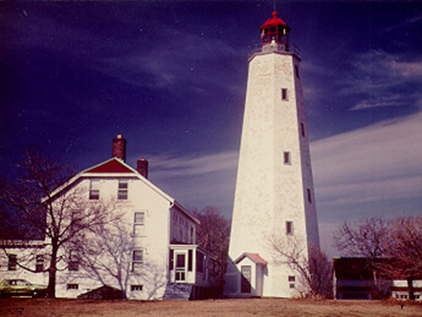
New Jersey: Powerhouse of Innovation and Economic Development
Notes:
There are lessons looking at the impact of “technology” on the development of the state…and the country. Lighthouses, canals and steamships help students to understand how changes in technology expanded the country’s economic success and how New Jersey and people from New Jersey were often at the forefront.
For example, we don’t think of lighthouses as technology, but in 18th century colonial America—lighthouses were the latest technology for ocean faring safety
New Jersey is home to the oldest operating lighthouse in the country—Sandy Hook Lighthouse. It was completed in 1764 with funding from NY City merchants who had been losing significant sums due to shipwrecks.
It was built 500 feet from the tip of the hook. Today, due to the northward expansion of the hook, it sow stands 1 ½ miles from the point.
The lamps installed in the crown were copper encased in a lantern of ordinary glass, the lighthouse keeper lived in a stone dwelling beside the tower. In order to pay for the upkeep of the lighthouse, a duty of three pence per ton was imposed on shipping using the channel into New York Harbor.
In early 1776, the American colonists destroyed the light at Sandy Hook Lighthouse to avoid aiding the British fleet that was shortly expected to appear off New York City, prior to the invasion of the city.
A British landing party relit the towers using improvised lamps and reflectors.
On June 1, 1776, the colonists again tried to extinguish the light this time using a pair of cannons mounted on several small boats.
They succeeded in damaging the tower somewhat before being driven off by an approaching armed vessel.

Slide 108
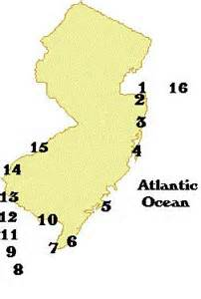

Across the Curriculum Lessons with Lighthouses
Notes:
There is a four-day lesson about lighthouses in NJ originally developed by a group of upper elementary teachers in Sayreville, expanded by the Center. It goes across the curriculum:
History: Sandy Hook Lighthouse and the American Revolution
Geography: Location of lighthouses in NJ
Math: Observations of height, color, shape (geometry)
Art: Draw your own lighthouse or color a lighthouse (North American Lighthouses Coloring Book)
Civics: Critical Thinking and Lighthouse Challenge
You can pick and choose what you’d like to do.

Slide 109
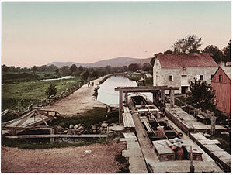
Canal Transportation in New Jersey
6.1.5.GeoHE2: Cite examples of how technological advances have changed the environment in NJ and U.S.
Notes:
There are lessons about using water power in many ways. One is the development of canals to move products and people.
Canals allowed boats towed by mules walking the side of the canal on a towpath to pull far more weight than it could pull while traveling on land. One horse or mule could pull less than a ton over roads but up to 30 tons of cargo loaded on a canal boat.
Again, many lessons across the curriculum:
A little lesson about how canal locks work
How did the development of canals impact the economies of New Jersey and the United States?
How did canals help to transform New Jersey from an agricultural society to an industrial society?

Slide 110
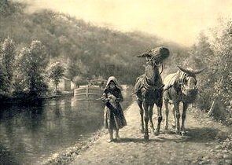
Children’s Literature Connections
A Full Hand (Thomas Yeserski, 2002)
Bridgetender’s Boy (Linda Barth, 2004)
Notes:
A some literature connections about canals:
Both A Full Hand by Thomas Yezerski (2002)
and
Bridgetender’s Boy by Linda Barth (2004)
involve young boys working as mule drivers on canals.
SHOW BOOKS
It sounds like really hard, dirty work.
Have your students consider: Would you like to work on a canal doing really hard, dirty work all day?

Slide 111
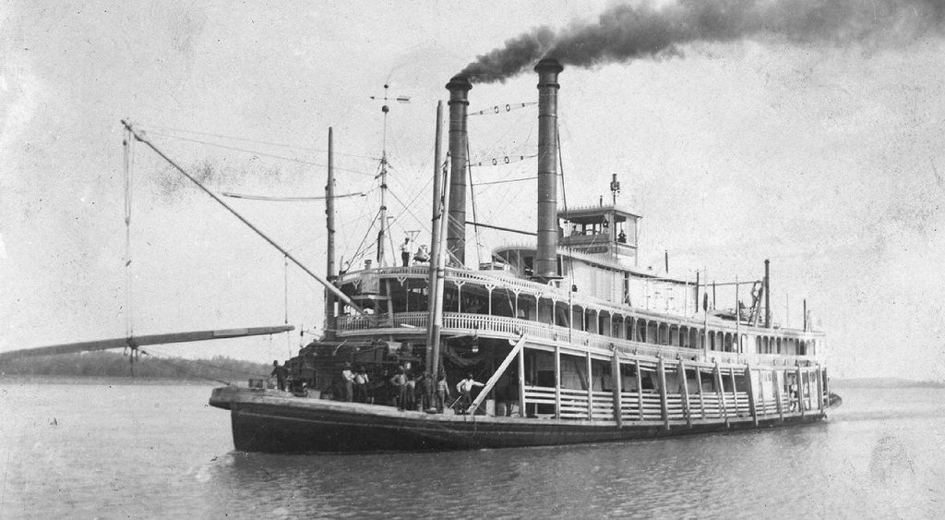
Steamboats and Steam Locomotives
New Jersey’s John Stevens constructed the first U.S. steam locomotive to successfully navigate open ocean to Philadelphia 1807
Stevens inaugurated the first U.S commercial ferry service in 1811 from Hoboken to New York City and obtained the first railroad charter in 1815 and designed and built a steam locomotive capable of hauling several passenger cars in 1825
Notes:
And we have NJ connections with steamboats and steam locomotives, also going across the curriculum:
At the same time that Robert Fulton’s first American steamboat left New York City for Albany (1806-7), inaugurating commercial steamboat service, New Jersey’s John Stevens constructed the first U.S. steam locomotive to successfully navigate open ocean to Philadelphia.
Stevens inaugurated the first U.S commercial ferry service in 1811 from Hoboken to New York City and obtained the first railroad charter in 1815 and designed and built a steam locomotive capable of hauling several passenger cars in 1825
And it was the operation of steamboats on the Hudson River between NY and NJ that led to the U.S. Supreme Court case of Gibbons v. Ogden in 1824 that made it clear that the federal government had the right to regulate interstate commerce

Slide 112
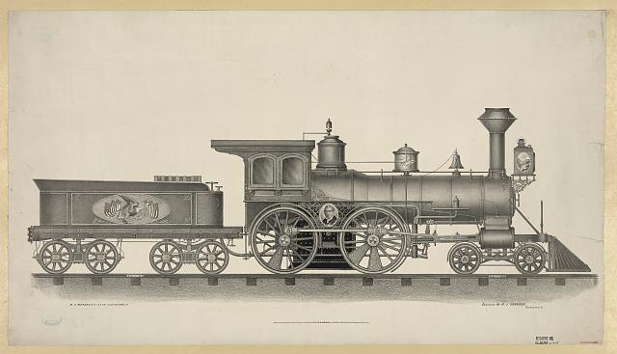
Trains Across New Jersey
Early Steam Engine Locomotive
Notes:
Our sense of time is related quite directly to our mode of transportation, which increased dramatically with the introduction of steam locomotives in the 1830s.
We have similar activities—math, science, history, etc.--for railroads, starting with: how does a steam engine work?
And ultimately asking the question: why did the railroads supplant the canals?

Slide 113
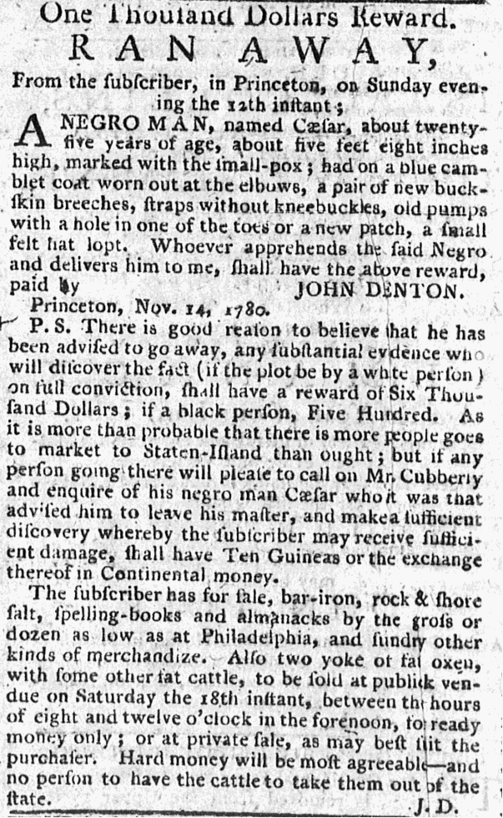
This is an ad from The New Jersey Gazette, Nov. 15, 1780 offering a $1000 reward for a runaway slave.
Source: Princeton & Slavery | "One Thousand Dollars Reward" for Caesar
Slavery in New Jersey
Notes:
By 1690, the enslavement of Black Africans existed in all British North American colonies, including New Jersey. Slavery spread as a response to the chronic shortage of free labor.
This is an ad from The New Jersey Gazette, Nov. 15, 1780 (https://slavery.princeton.edu/sources/caesar-1)
It is offering a $1000 reward for the return of a fugitive slave. That is a great deal of money in 1780. That would be more than $20,000 today.
Look at how much detail there is in the ad. Do you think that somebody might take the time to find and return this person?
I think the value of actually having students see the ad is for them to appreciate that this was real. This was happening. This was part of our history, whether we like it or not.

Slide 114
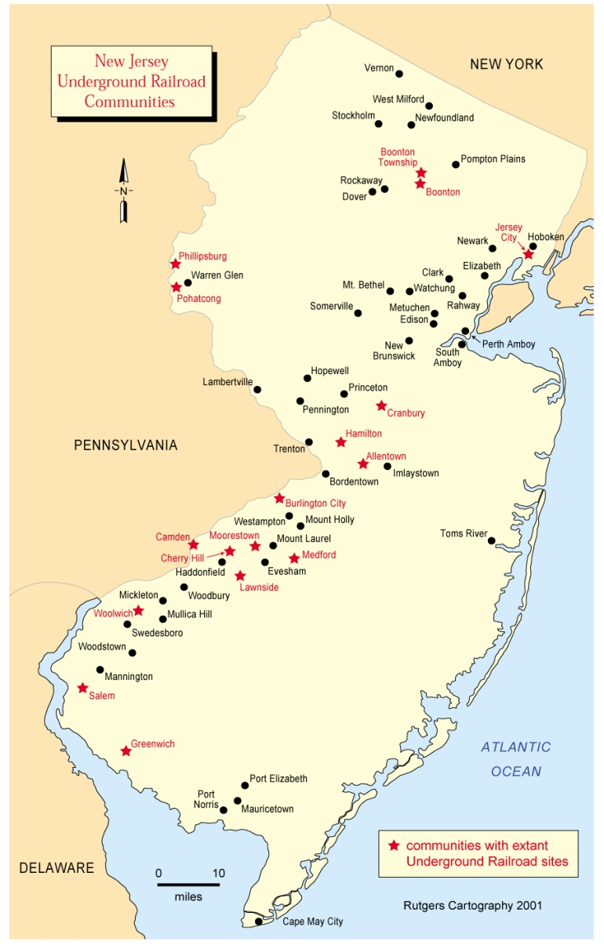
The Underground Railroad in New Jersey
Why did an underground railroad go across New Jersey?
How long would it take to walk from Richmond Virginia to Jersey City—328 miles—walking 10 hours a day?
Notes:
By the 1830s, the Underground Railroad had become legendary when abolitionists and other sympathizers began helping slaves escape to freedom.
Following increased pressure from Southern politicians, Congress passed the Fugitive Slave Act of 1850
We have a map lesson, a history lesson, a math lesson and a geography lesson about the Underground Railroad, starting with Why did it go across NJ?
NJ was close to the two most active URR cities—NY and Phil--and to MD and DE
Also large number of all-black communities in NJ that served as sanctuaries for fugitive slaves. For example, in the mid 1800's Salem County, NJ had a population of 2,075 free blacks and a large number of Quakers, all who aided them in their escape. No other northern state exceeded New Jersey in the number of all-black communities that served as URR sanctuaries for southern fugitive slaves.
Math: how long would it take for a fugitive slave to travel from, say, Richmond, Va., to Jersey City—328 miles if you walked 10 miles a day.
Map: Where did fugitive slaves go?
Fugitive slaves crossed the Delaware Bay to New Jersey, travelled across at various safe houses to Jersey City and at the Morris Canal basin fled by boat across the Hudson River (called the “River Jordan”) to go to Canada, New England or New York City.

Slide 115
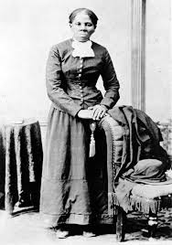
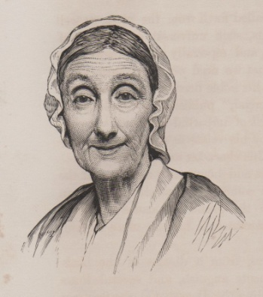
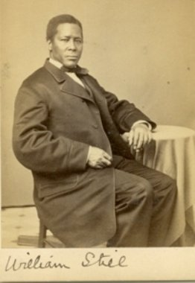
New Jersey “Conductors”
Abigail Goodwin
William Still
Harriet Tubman
Notes:
How did the Underground Railroad work? Who helped fugitive slaves escape across New Jersey? The lesson highlights not only:
Harriet Tubman who brought more than 300 slaves from the south over ten years and partially funded her efforts by working summers in Cape May, NJ.
But also, William Still, a free man in Burlington Co born a slave, moved to Phil and became director of the General Vigilance Committee of Phil, obtaining funds and establishing a network of safe houses
And, Abigail Goodwin, a Quaker in Salem, whose house was a station of the URR
You could have your students read a biography of Harriet Tubman, such as Moses: When Harriet Tubman Led her People to Freedom or Harriet Tubman: The Moses of her People and/or watch the PBS video at http://video.pbs.org/video/2181724307/
Or Watch the video about Abigail Goodwin at http://7stepstofreedom.wordpress.com/2011/07/28/abigail-goodwin/
Or read and compare the stories of fugitive slaves that William Still collected and published as The Underground Railroad: Authentic Narratives and First-Hand Accounts in 1872.
Also houses to visit in NJ which held enslaved people, as well as underground RR stops in NJ

Slide 116

An effective social studies curriculum cannot avoid controversial issues!
Nor should we try to avoid them…

Slide 117
Research shows that…
Discussing controversial public issues:
Is authentic and relevant
Motivates students
Enhances political efﬁcacy
Develops political tolerance
Improves critical thinking skills
Increases student comfort with conﬂict in the world outside of classroom
Results in students gaining greater content knowledge
From: Diana Hess, Controversy in the Classroom, 2009.
Politics in the Classroom in these Divided Times? Now More Than Ever, says Educator Diana Hess (Ep. 24)117

Slide 118

Teaching Controversial Issues
Look at your school policy about teaching controversial issues.
Let your administrators know what you plan to do
Reference the state standards and your district course curriculum
Know what is controversial in your community
Know the goals of your lesson
Consider carefully whether you should disclose your personal views
Always avoid indoctrinating your students to your point of view
Resources for Teaching Controversial Issues
Notes:
You may consciously (or unconsciously) avoid controversial issues in the classroom because of the difficulty involved in managing heated discussions and/or for fear that parents will complain or that the school administration will admonish or punish them for “being controversial.” These concerns are certainly not groundless.
We suggest an ounce of prevention:
Be prepared for controversy by letting your administrators know what you plan to do
Reference the state standards and your district course curriculum that supports teaching this topic--Unlike other states which are trying to exclude topics from being taught, the NJ SS standards are broad, progressive and encourage teaching controversial topics. Your school board should be supporting you
Look at your school policy about teaching controversial issues, which protects teachers unless they are “indoctrinating” students
Know your community—be aware of what might be controversial
Know the goals of your lesson that might be controversial
Consider carefully whether you should disclose your personal views—for middle school students, probably not.
BOTTOM LINE: DO NOT TRY TO INDOCTRINATE YOUR STUDENTS WITH YOUR VIEWS.

Slide 119
Protections and Limitations
for New Jersey Teachers
Unlike many other states, New Jersey has taken a very broad approach to classroom content:
with a framework of state standards for each content area
while leaving significant control to local school boards
New Jersey teachers are protected as long as they teach:
within the state standards and the local curriculum
in a neutral, balanced manner that does not seek to indoctrinate
First Amendment protection of academic freedom for New Jersey teachers is not absolute.
A teacher has no right to substitute his own book list for the one approved by the district without permission or consent (Kirkland v. Northside Ind. School District, 1989)
Notes:
New Jersey has taken a very broad approach to classroom content, and unlike many other states which establish a state curriculum, leaves significant control to local school boards.
The First Amendment protects academic freedom for teachers BUT this protection is not absolute: teachers must be teaching within the state standards and within their local school curriculum. NJ teachers are protected as long as what they are teaching is within the state standards and the local curriculum and is being taught in a neutral, balanced manner that does not seek to indoctrinate students.

Slide 120
Where can you find resources?
We the People: The Citizen and the Constitution and Project Citizen can be purchased at Partner Intake Form
iCivics at How to Use: Games - iCivics
Educating for American Democracy resources at https://www.educatingforamericandemocracy.org/educator-resources/
NJ History and Government lessons are available free online at the NJ Center’s website at https://civiced.rutgers.edu/njlessons.html
NJ Dept. of Education Foundations of Democracy for K-5 at Foundations Of Democracy — RevNJ.org
NJ State Bar Foundation at Online Civics & Mock Trial Content - New Jersey State Bar Foundation
NJ Holocaust Commission at Holocaust Curriculum Guides Kindergarten - 4th Grade
Amistad Commission at Resources
National Geographic for kids at National Geographic Kids
Notes:
Where can you find the resources that have been mentioned?
Project Citizen and We the People: The Citizen and the Constitution are all available from the Center for Civic Education. Gibbs Smith Education is now the selling agent for the Center for Civic Education’s materials.
iCivics games and lessons are available online at iCivics.com
Educating for American Democracy
NJ History and government lessons are available free online at the NJ Center’s website at civiced.rutgers.edu
Nj Dept. of Education Foundations of Democracy for K-5—you will see since we worked with the Dept. that they took our ideas for core concepts. Explore for a few minutes.
There are also resources available from the NJ State Bar Foundation, the NJ Holocaust Commission, the Amistad Commission and National Geographic for kids.
So we’ve provided you with all sorts of ideas and resources, I thought that it might be valuable if you spent a little time identifying what you might like to add to what you’re currently doing in your classroom from any of these sites. Just an idea that you can flesh out later. You may want to do this with somebody in a small group or by yourself. So let’s take the next 15 minutes or so to do that.

Slide 121

Contact us with any questions:
Arlene Gardner at arlenega@sas.rutgers.edu
Craig Uplinger at cu88@scarletmail.rutgers.edu
Albert Paulsson at apaulsson@sas.rutgers.edu
Visit the NJ Center for Civic Education website at the New Jersey Center for Civic Education
We will email you a today’s PowerPoint and PD certificate
Notes:
2:15 CRAIG
We’d be happy to answer any questions now.
Or send an email with any thoughts later on…
Visit the New Jersey Center for Civic Education website at http://civiced.rutgers.edu/ for New Jersey history and civic education materials.

